Slide 1

2019 Year in Review for
Living Waters International

Slide 2
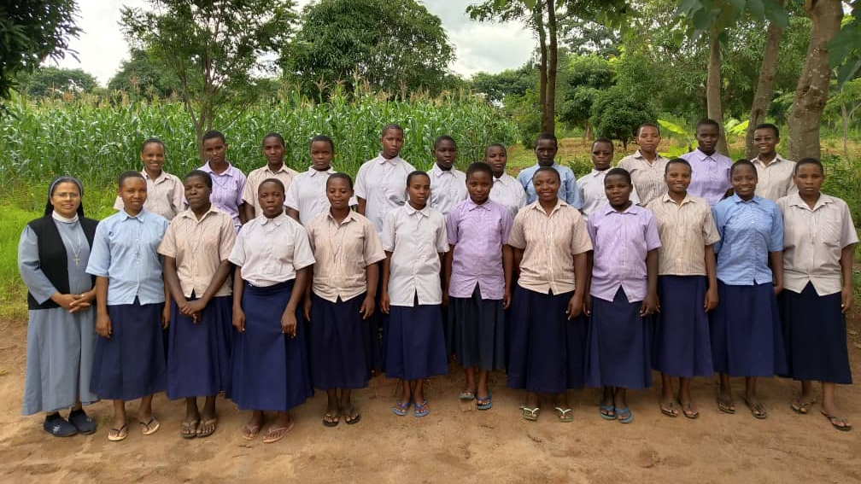
The Society of the Ursulines of Mary Immaculate Congregation formation program in Tanzania

Slide 3
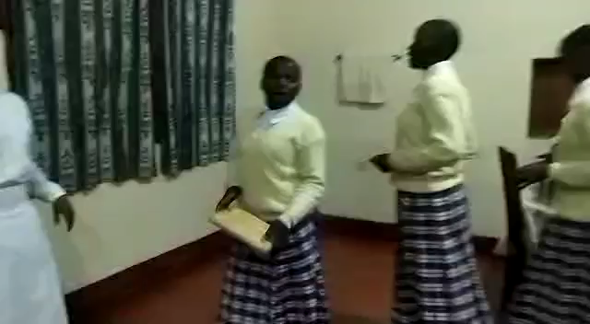

Slide 4
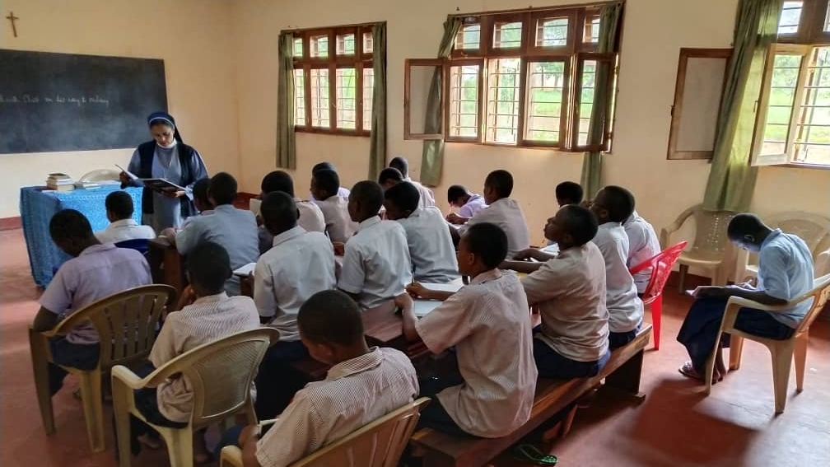
In the Classroom

Slide 5
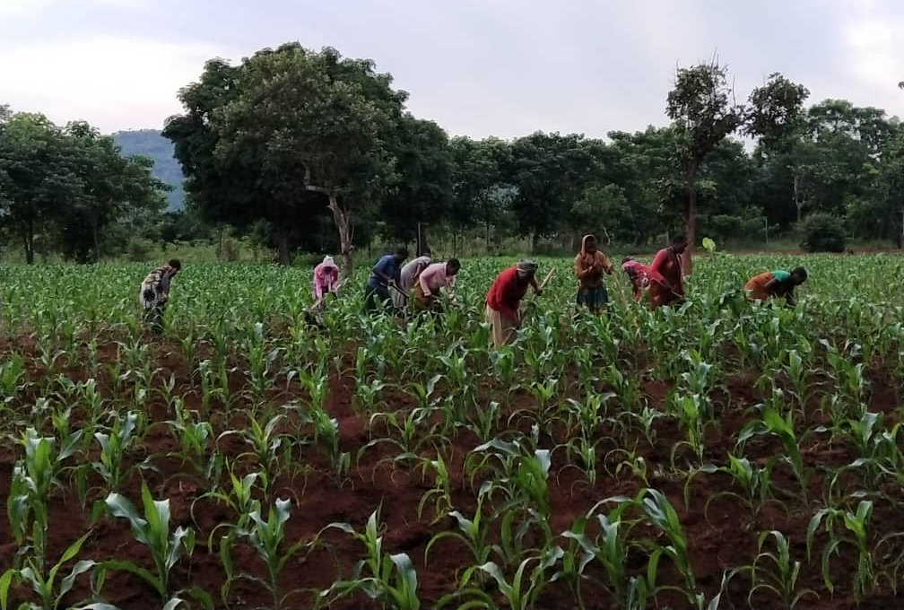
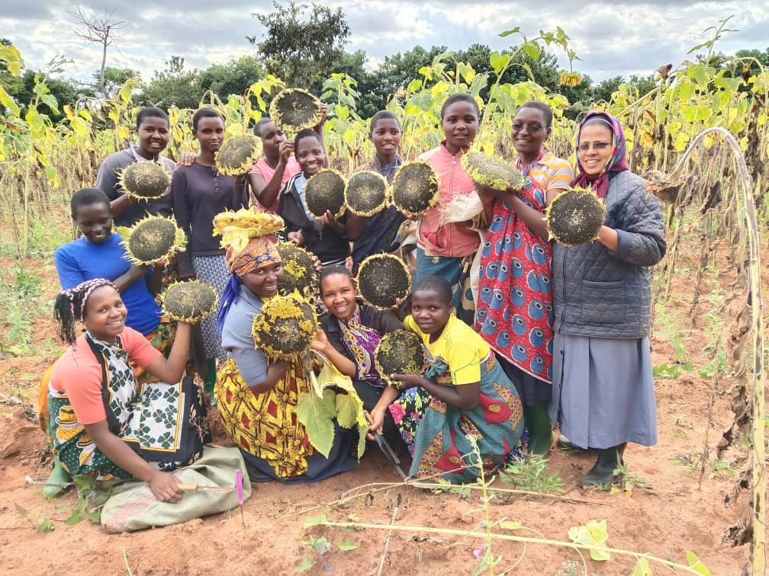
Kazi ya Shambani
Field Work

Slide 6
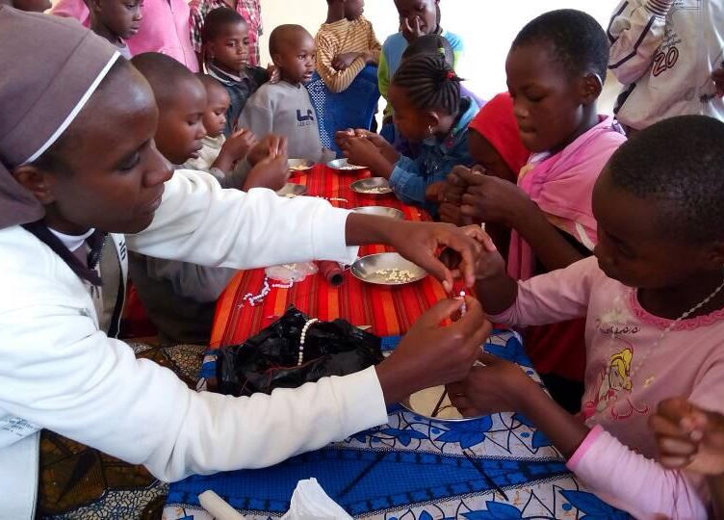
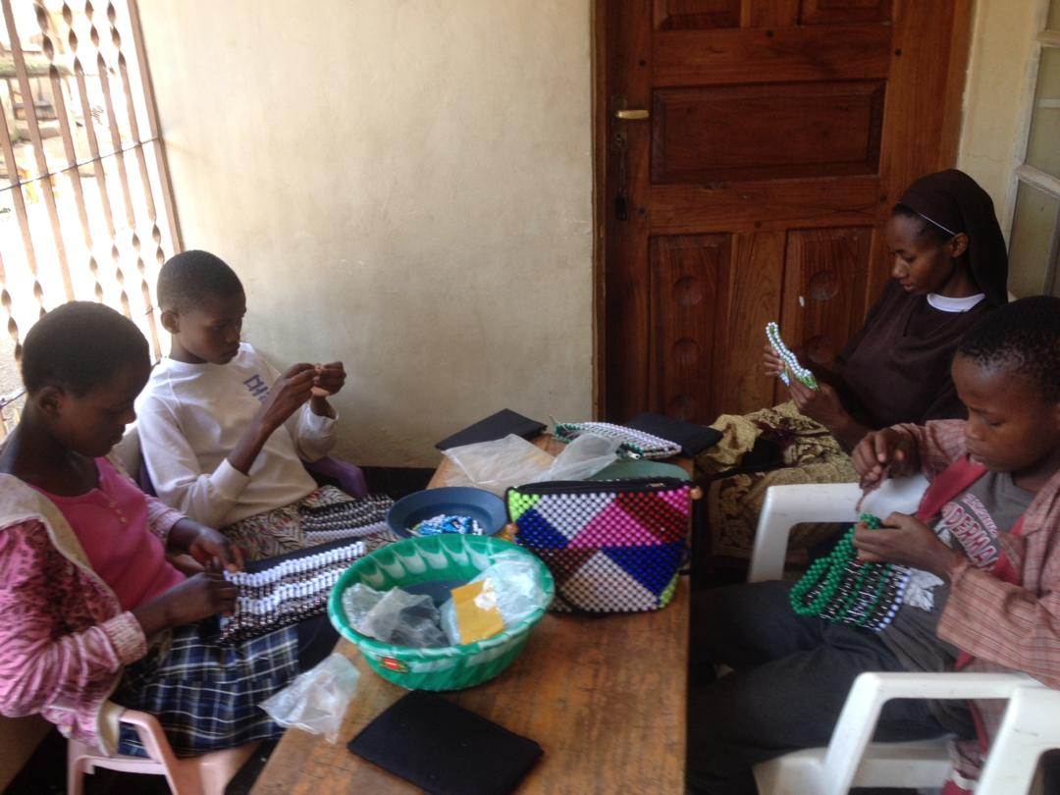
Orphans and poor children at Mother Kevina Feeding Center- Kijenge, in the Arusha Archdiocese of Tanzania

Slide 7
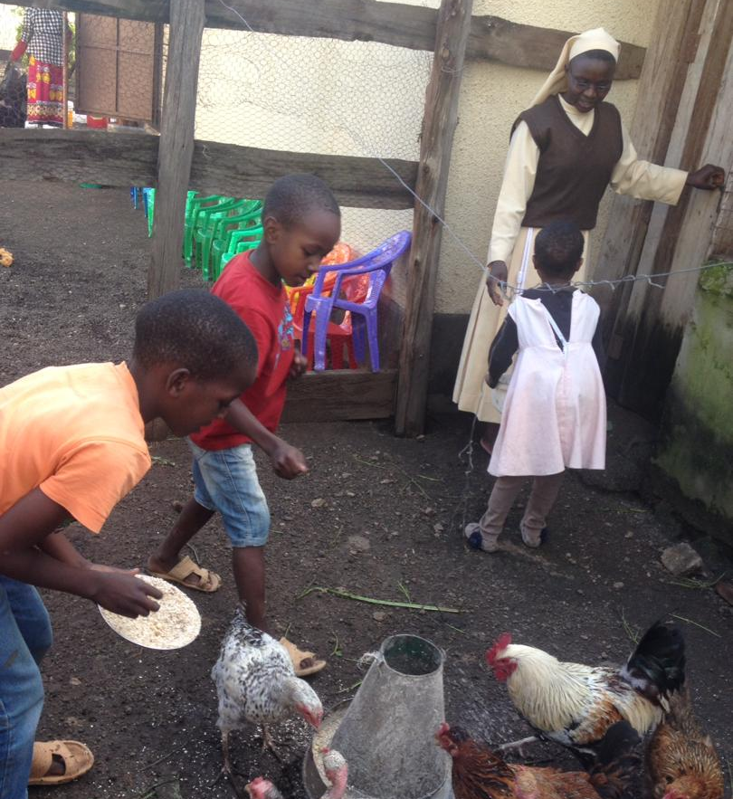
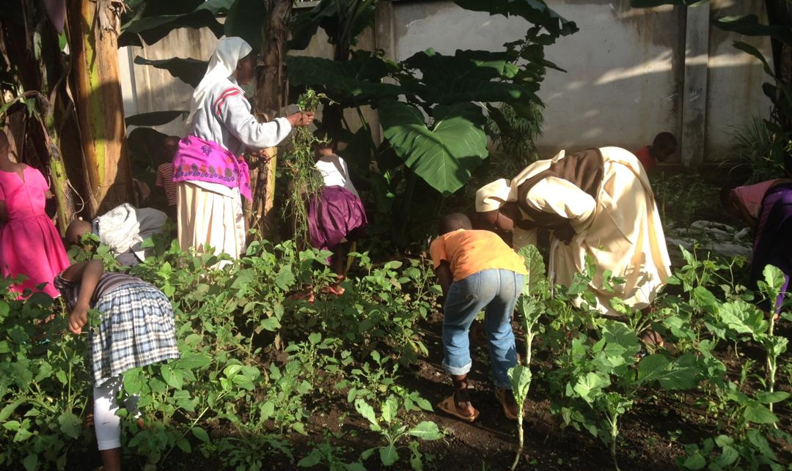
Feeding the chicken
Children tending the garden

Slide 8
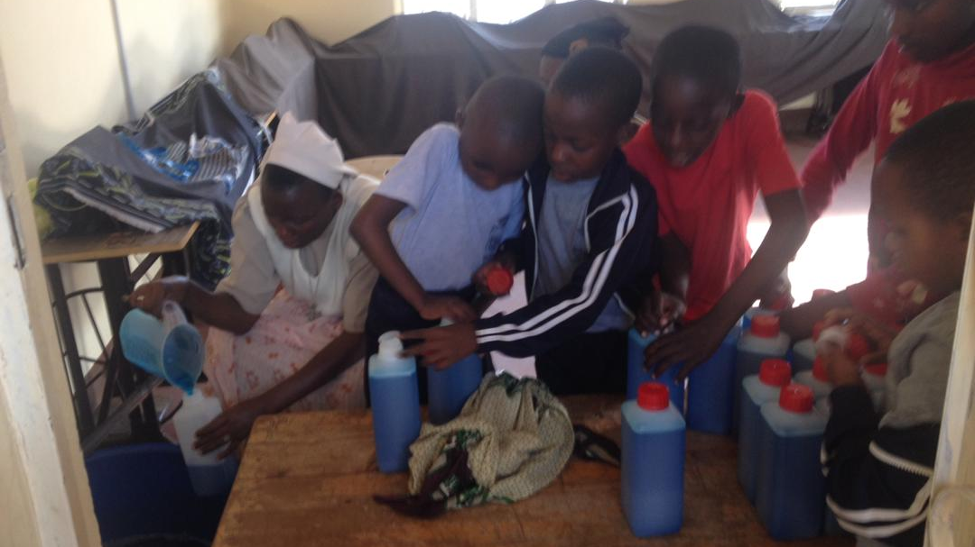
Children at Play

Slide 9
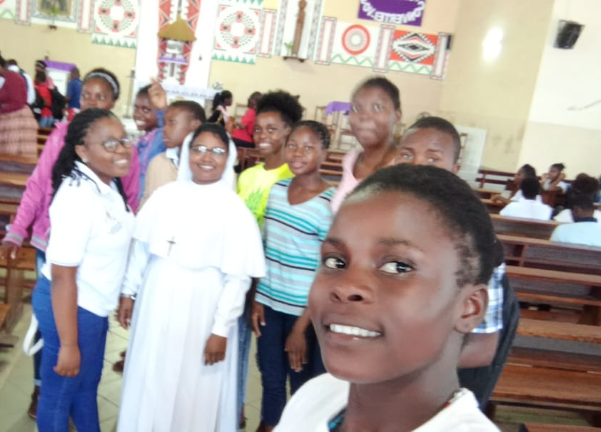
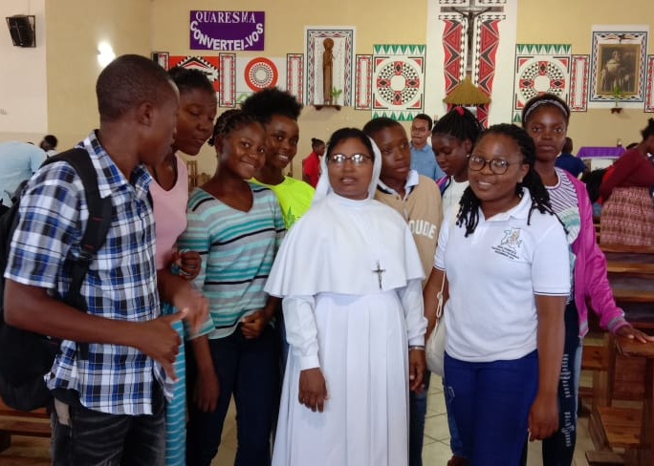
Catechists training at Ponta do Ouro, Mozambique

Slide 10
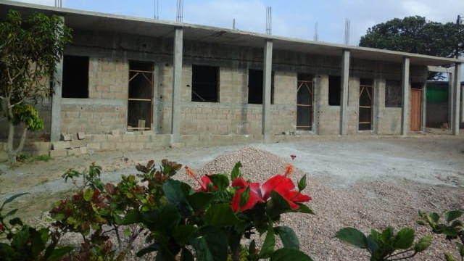
Kindergarten at Ponta do Ouro, Mozambique

Slide 11
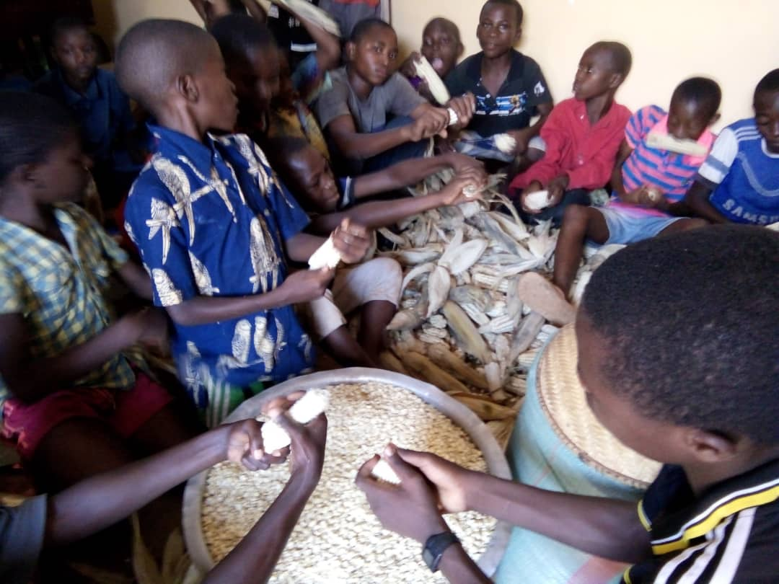
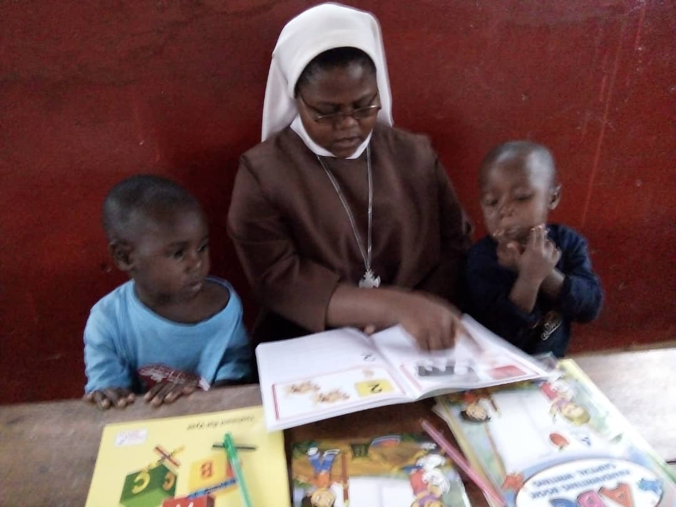
Street Children’s Home
Kigoma, Tanzania

Slide 12
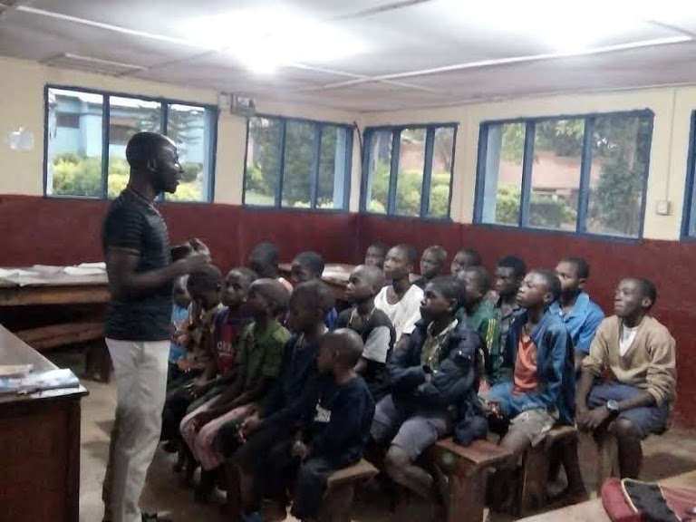
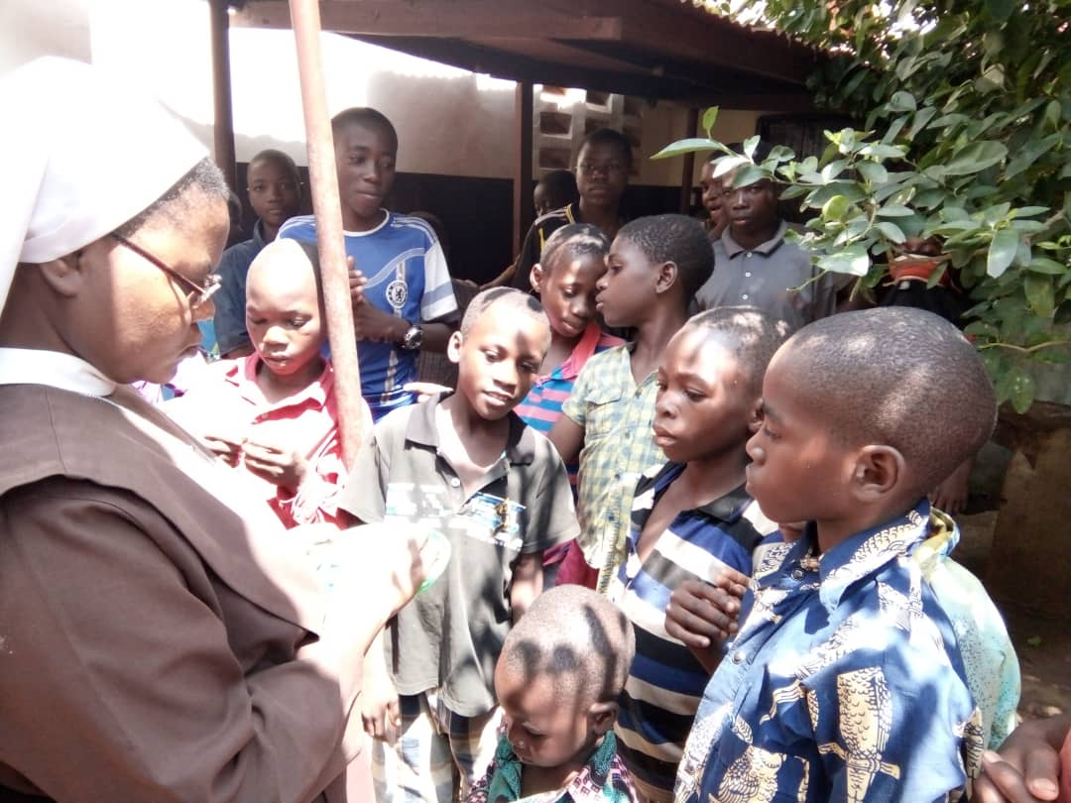
Teaching moments for the Children

Slide 13
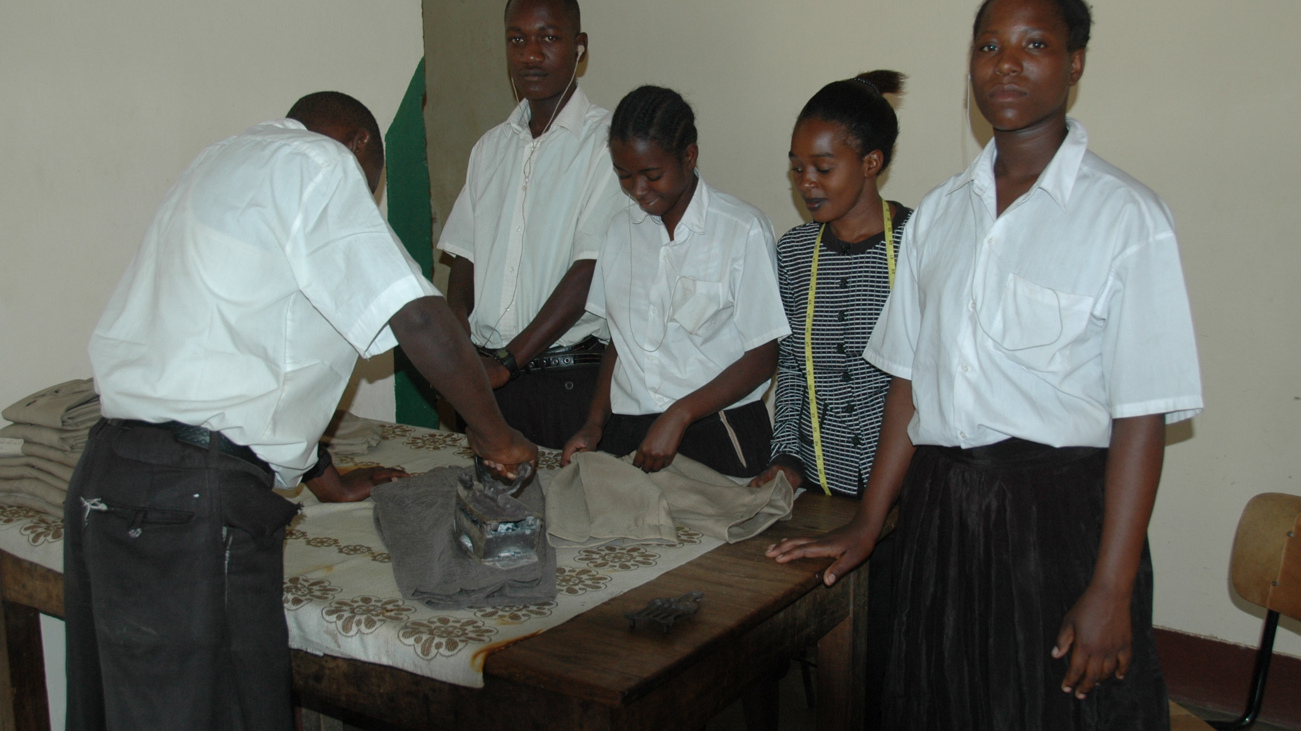
Igange Vocational Training Centre for the Deaf in the
Tabora Archdiocese of Tanzania

Slide 14
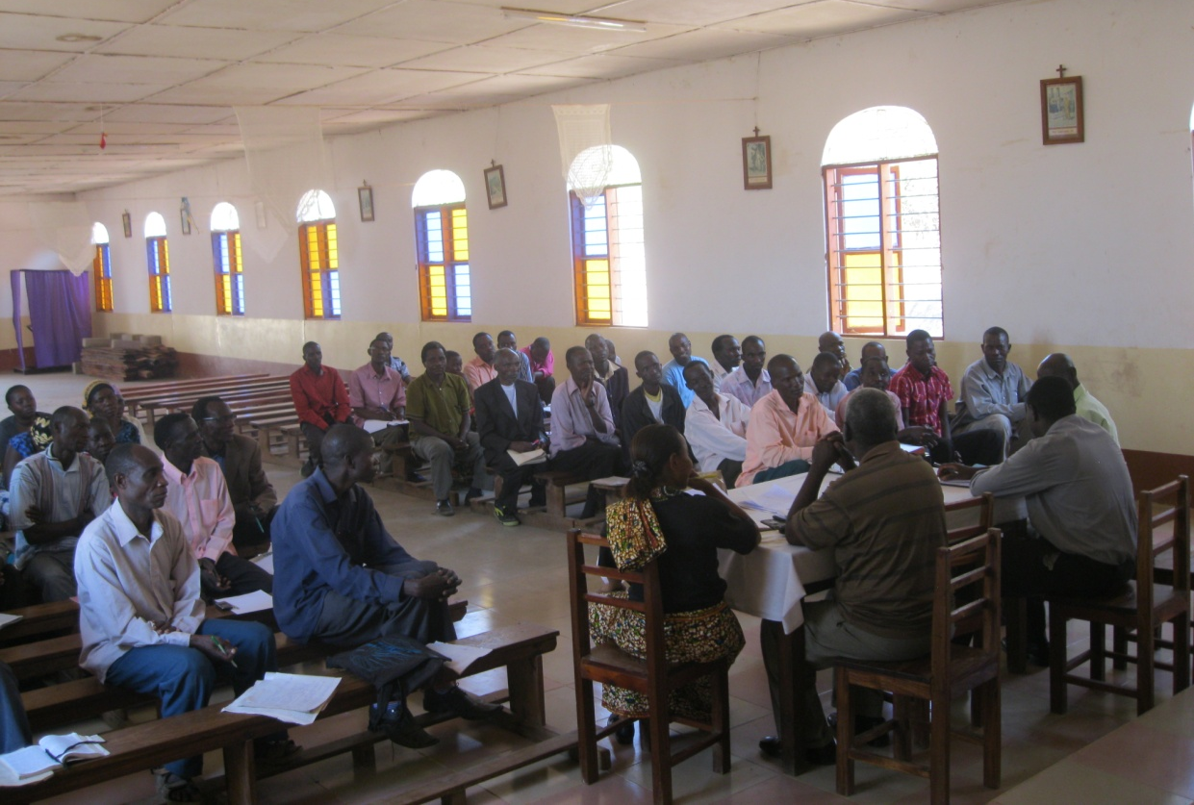
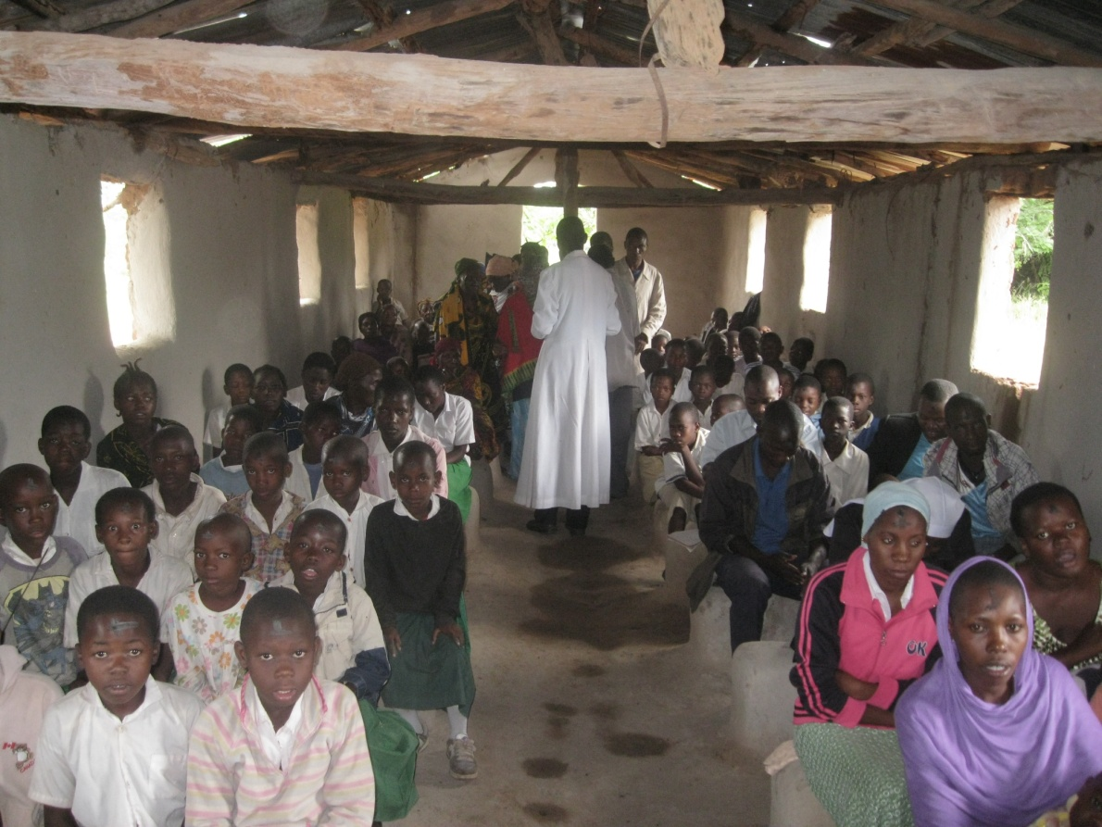
Lay leaders of Small Christian Communities from 19 outstations of Magiri Parish gathered for Training
Ash Wednesday Celebration at Kakulungu Outstation

Slide 15
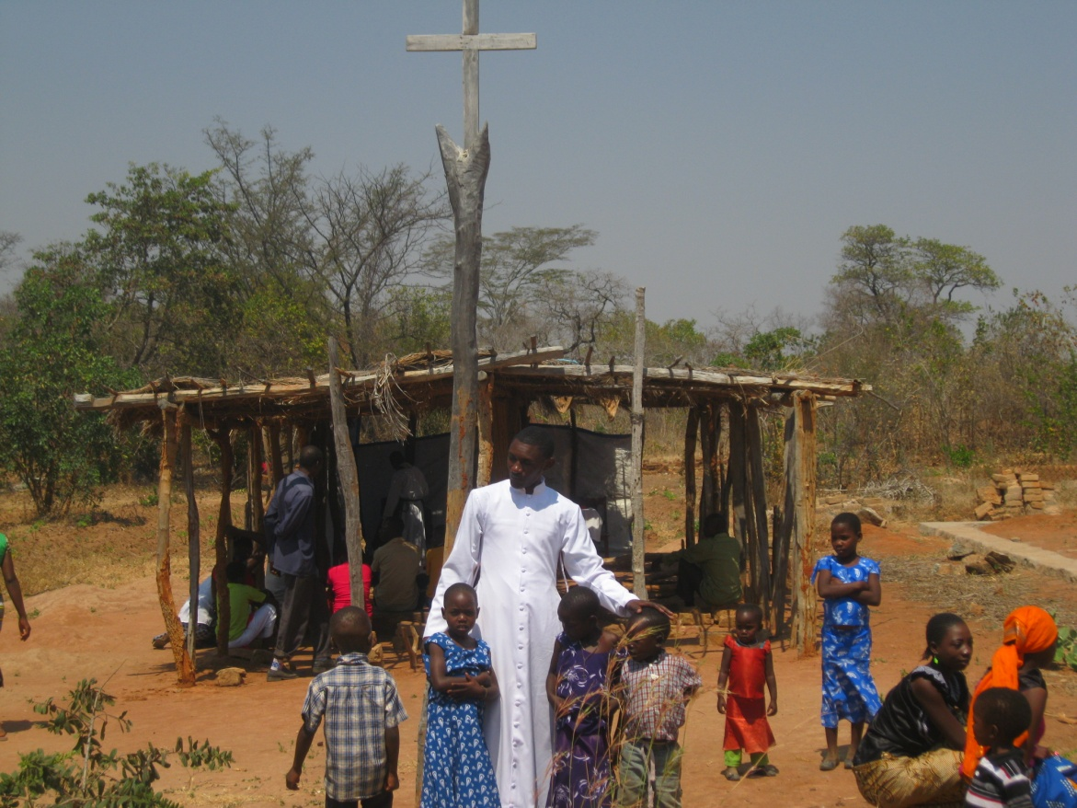
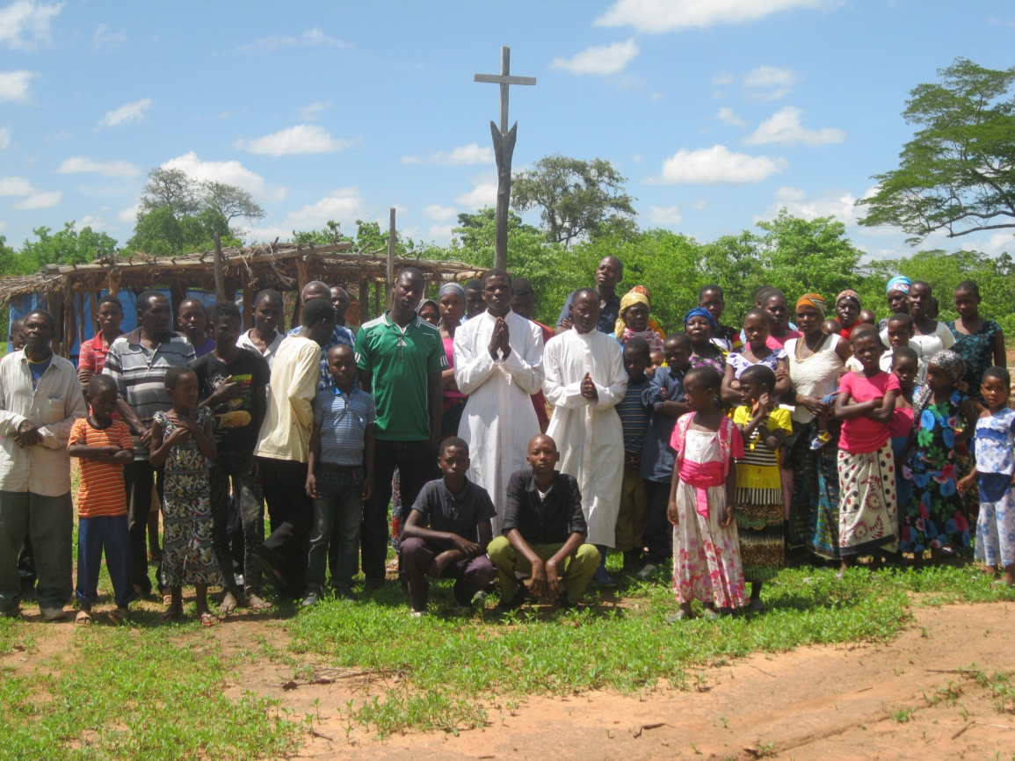
Catechists of Kalumbi outstation of Magiri Parish, Tabora Archdiocese
with the faithful and children after Sunday celebration

Slide 16
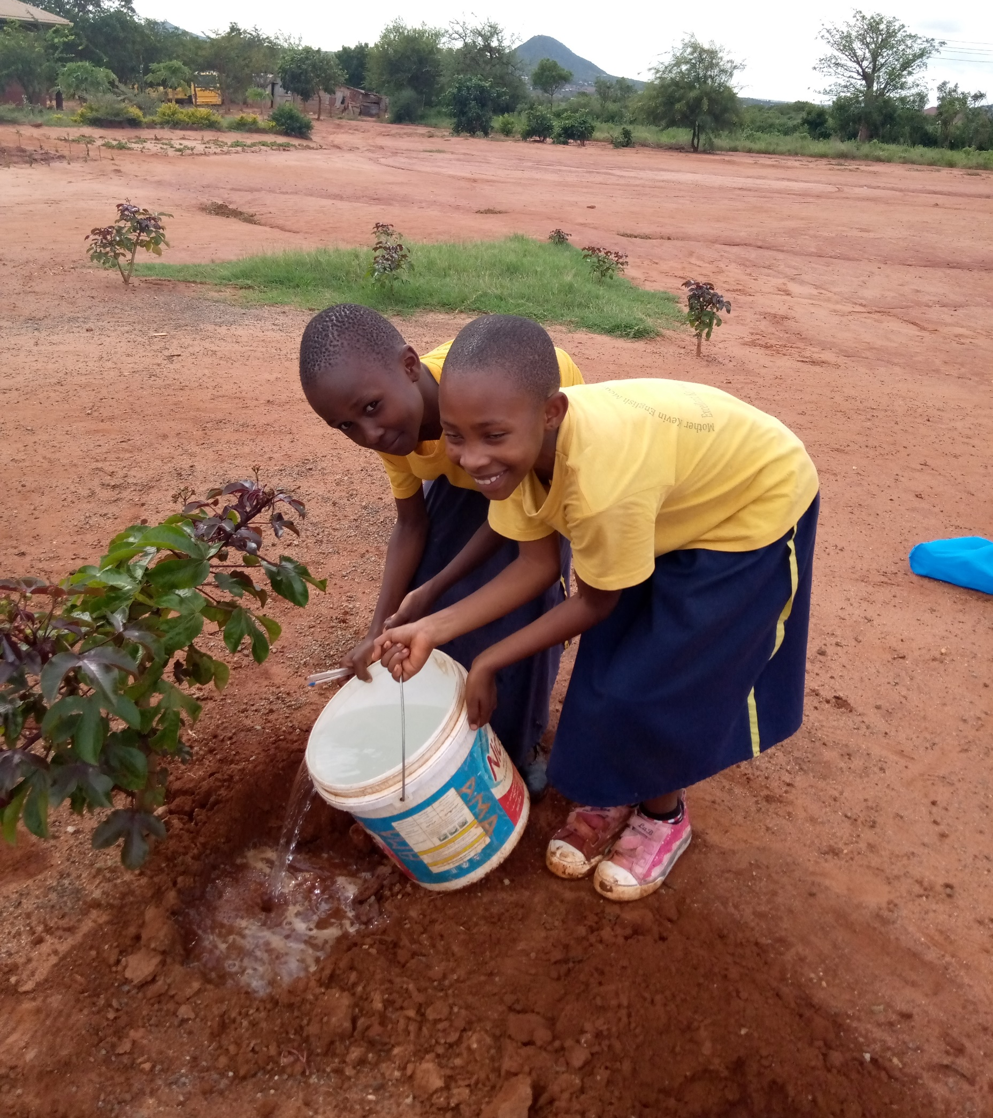
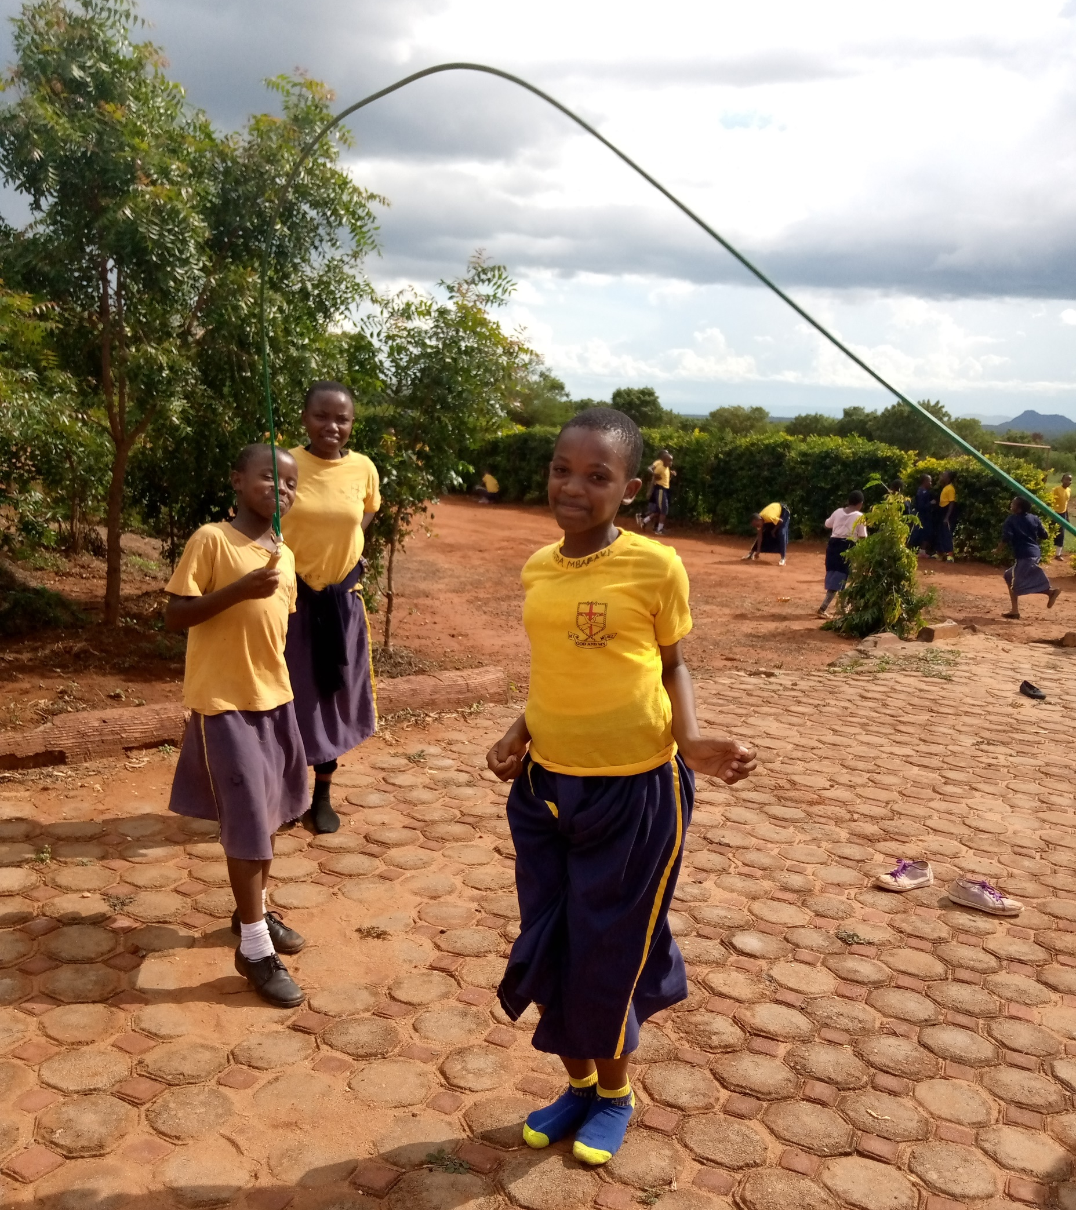
Mother Kevina English Medium Primary School, Chambogho village, Same Diocese of Tanzania

Slide 17
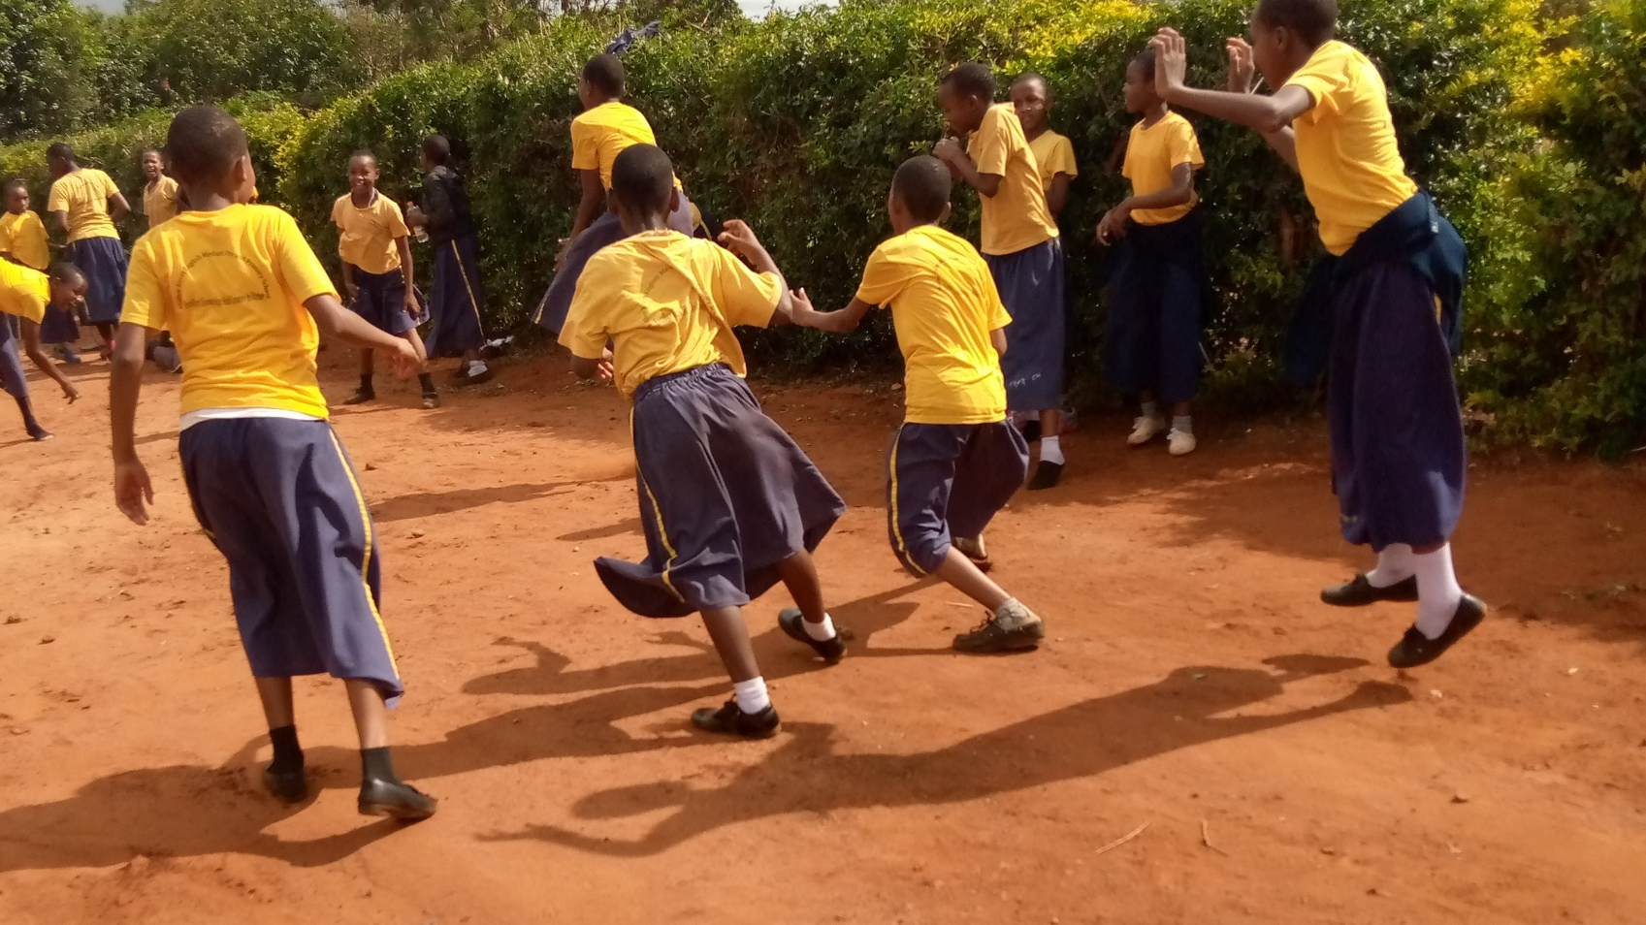
Supported by the Little Sisters of St Francis of Assisi

Slide 18
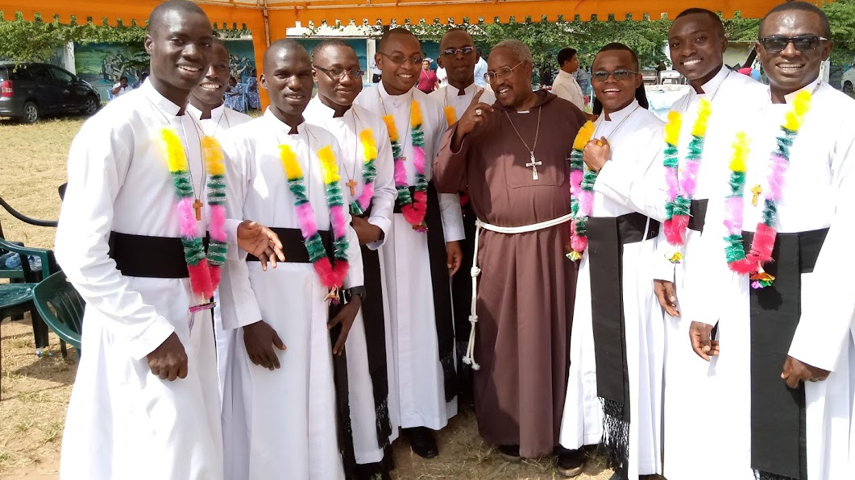
MSFS Novices Day of First Profession, July 2019, Kibaha, Tanzania

Slide 19
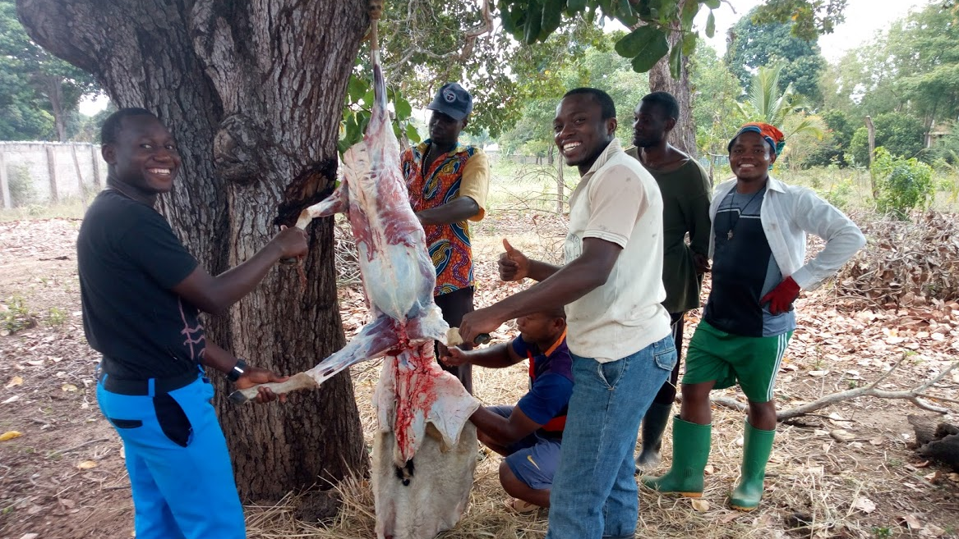
The Celebration to Follow

Slide 20
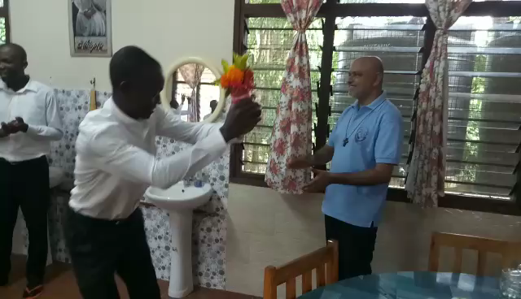

Slide 21
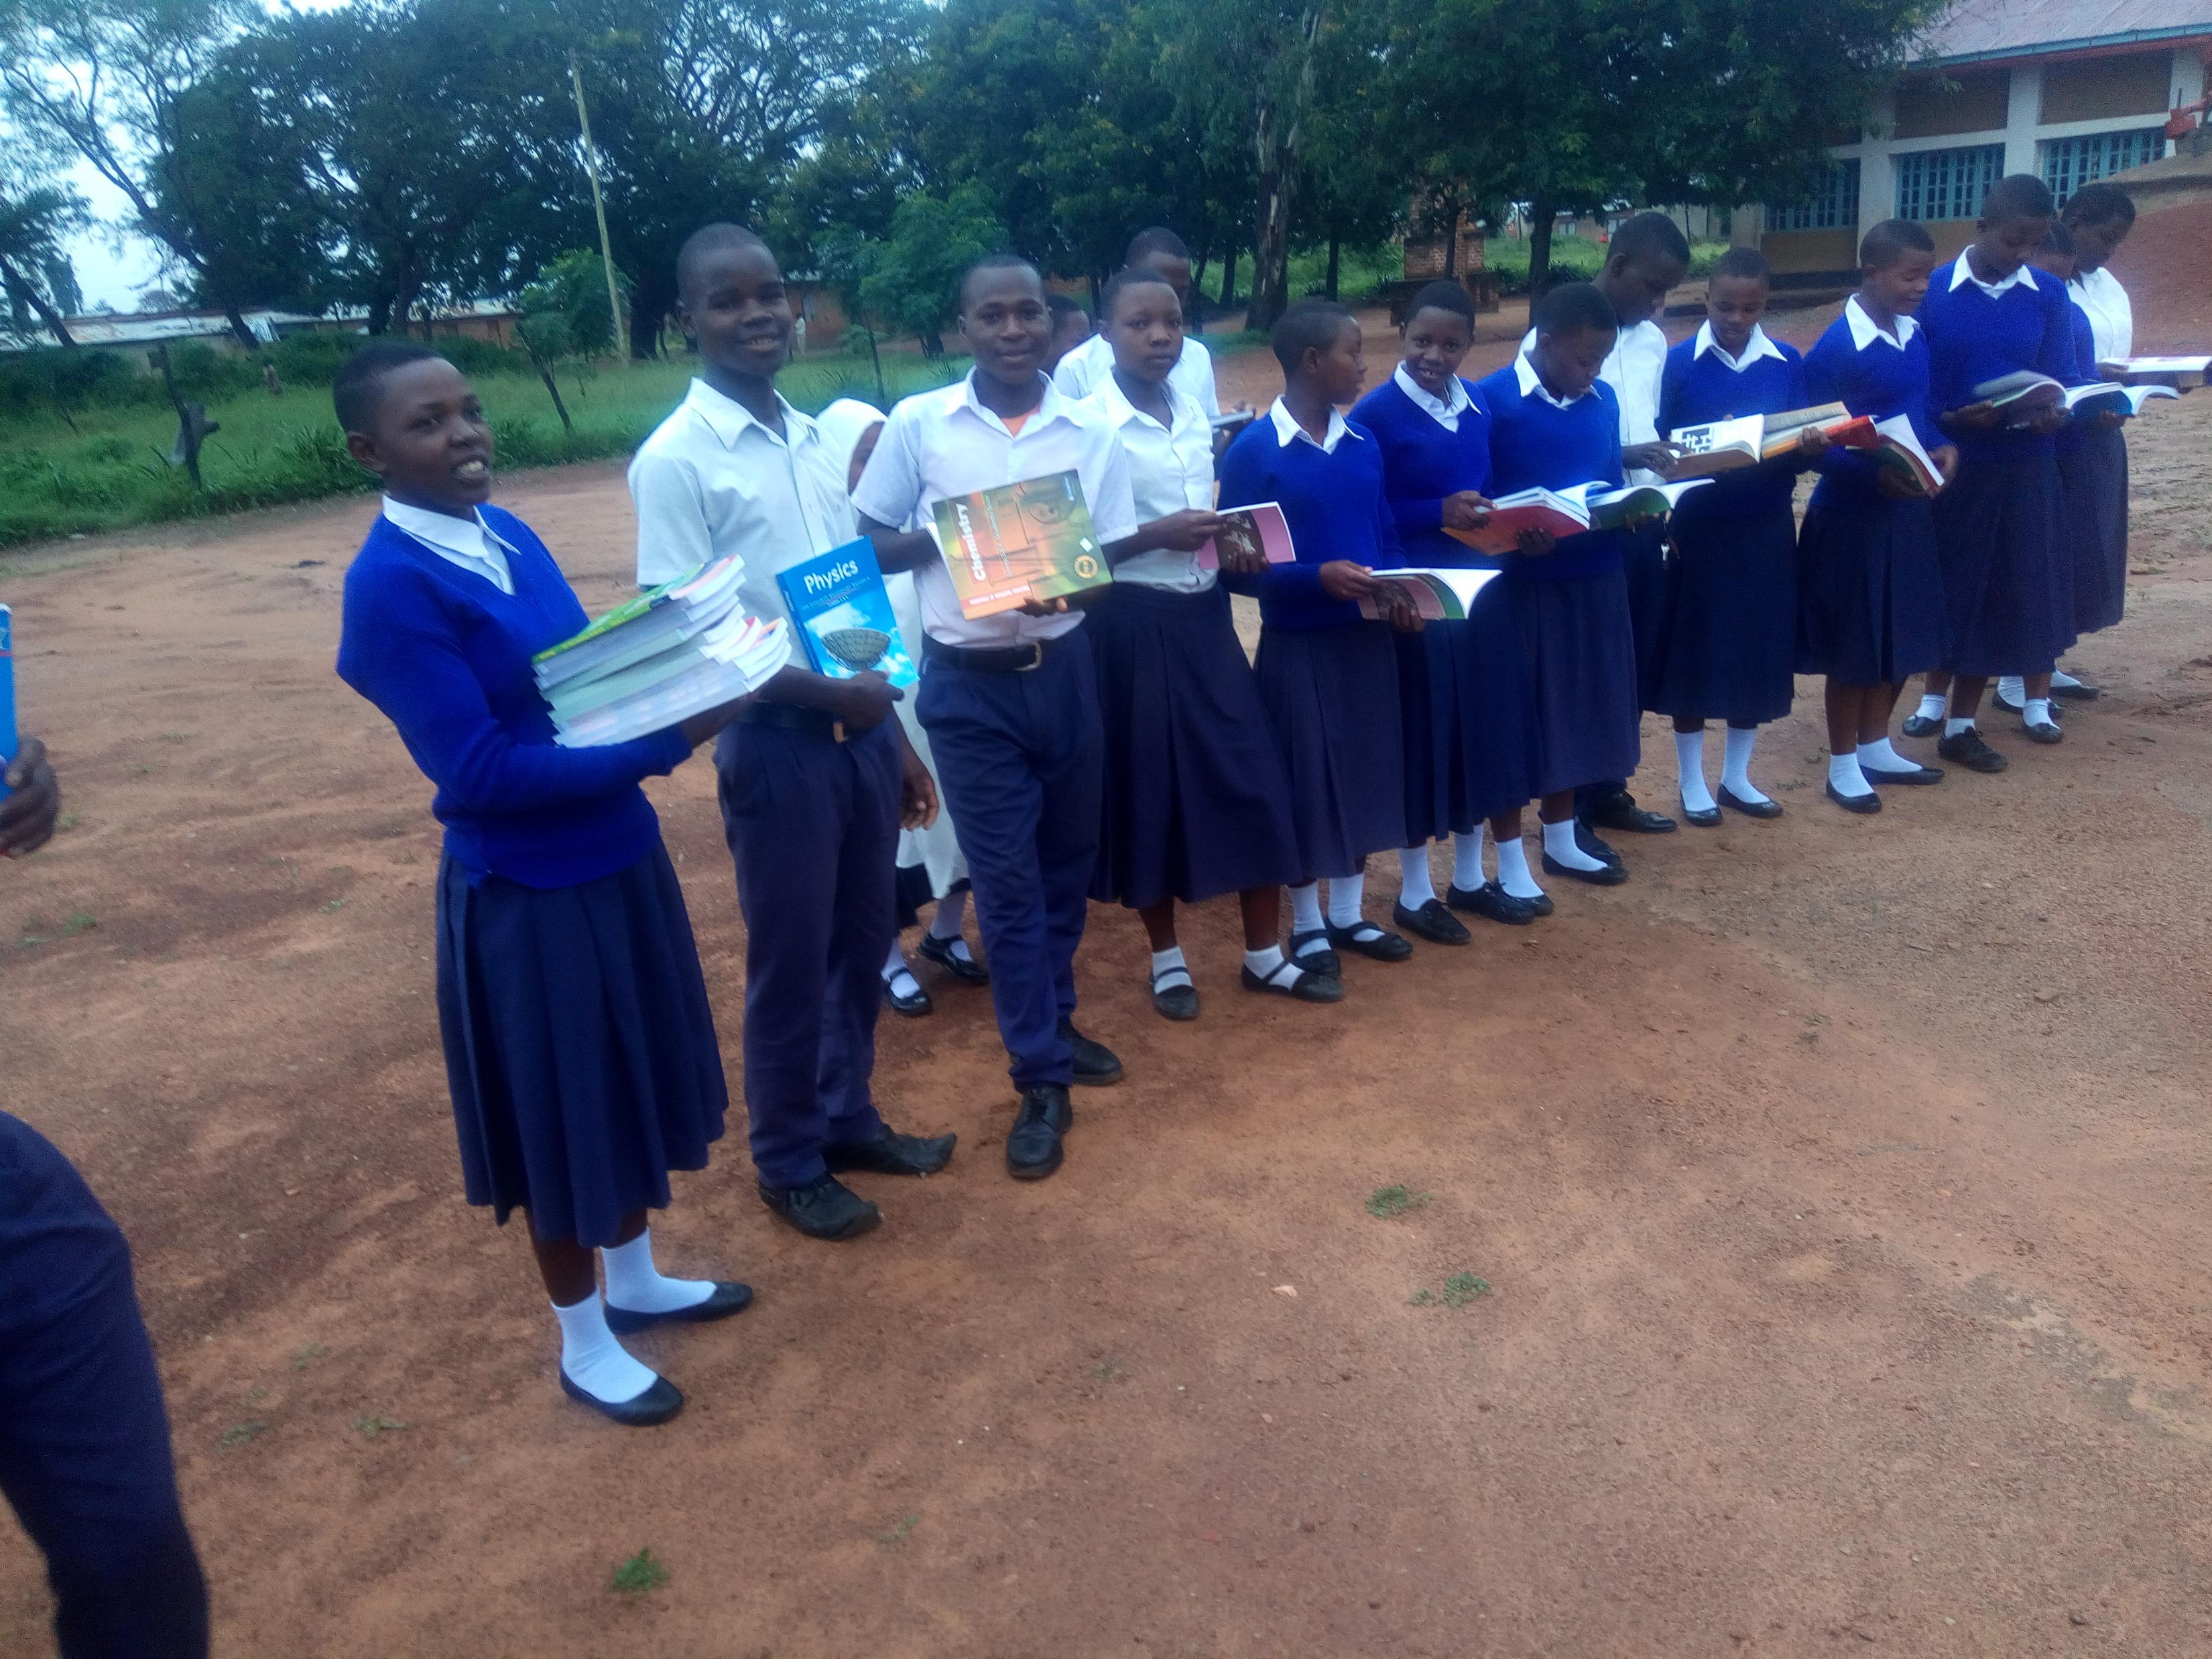
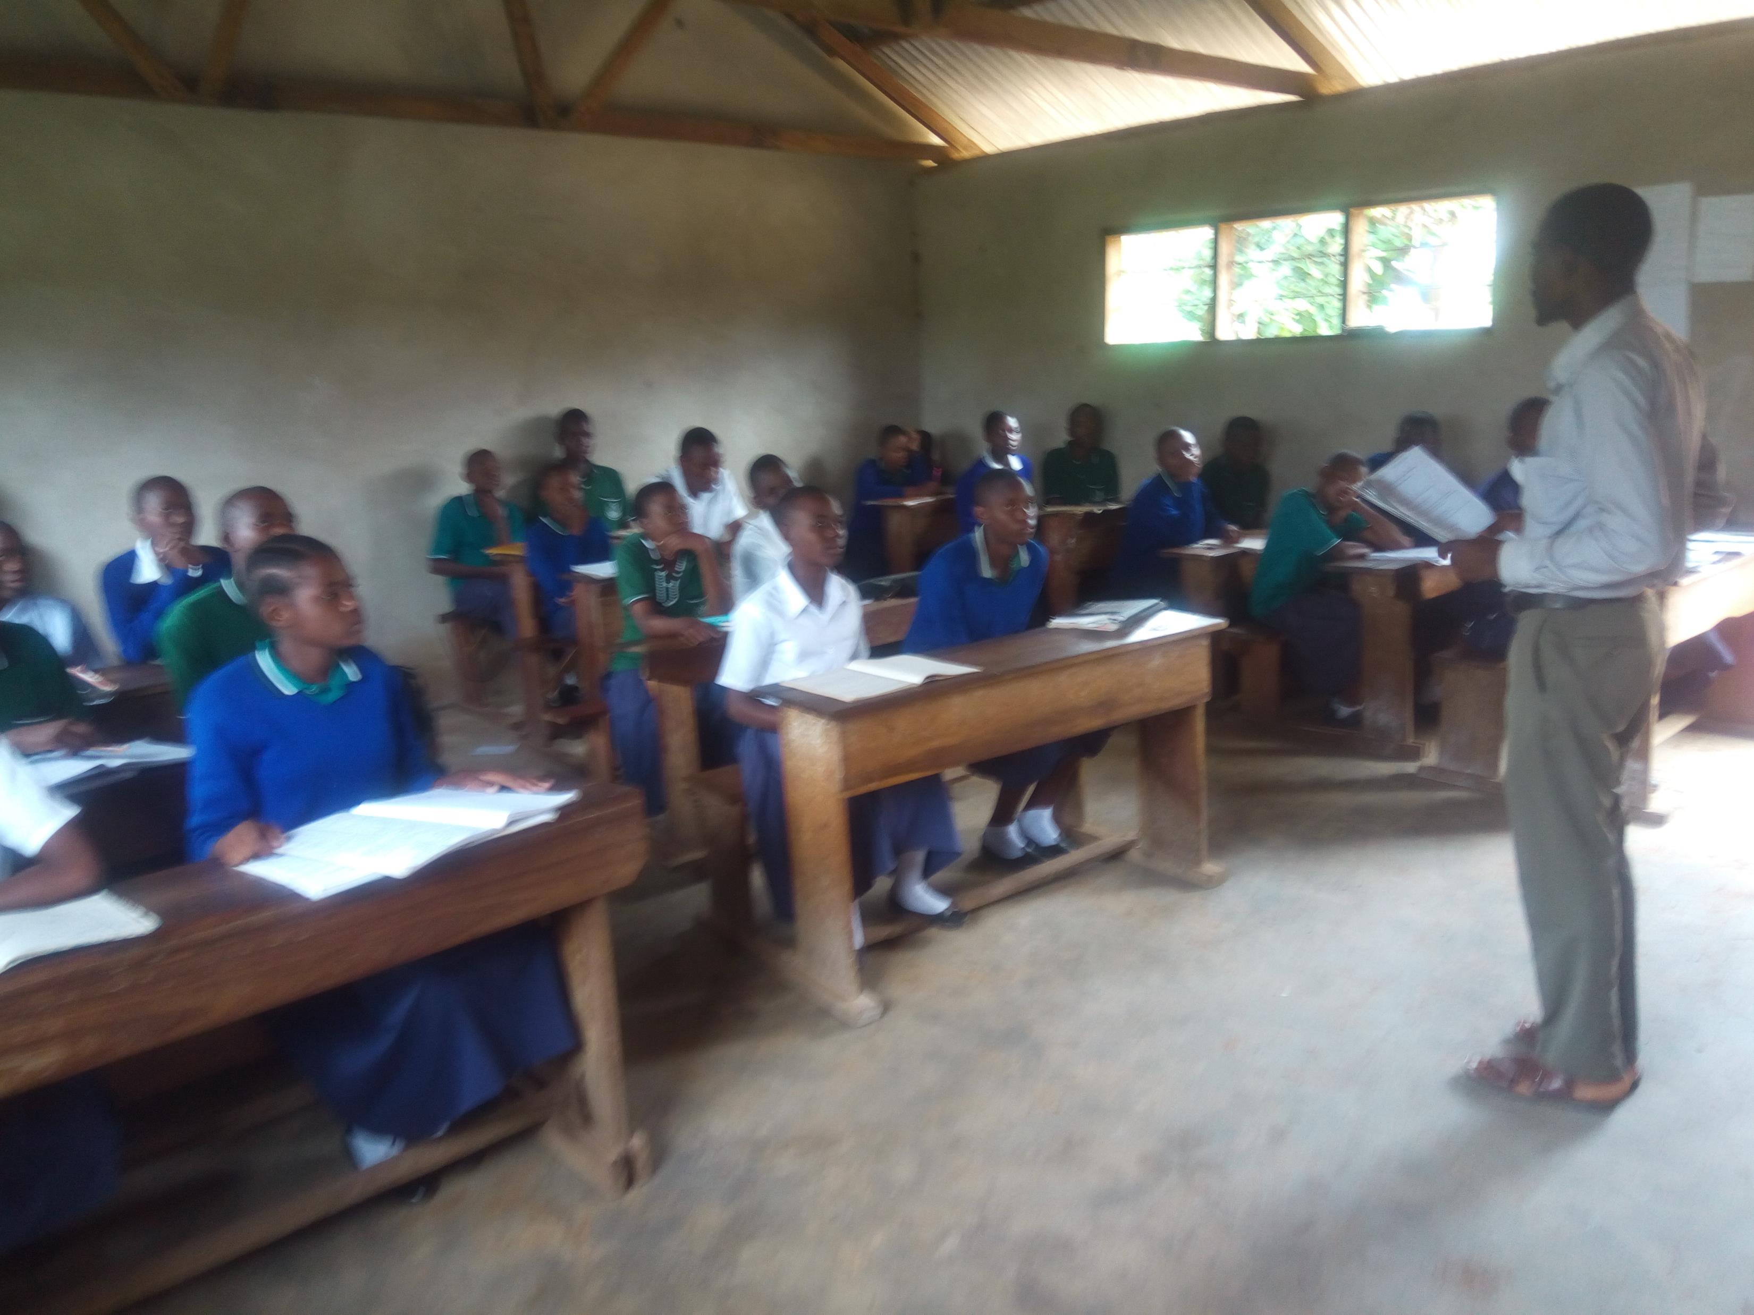
Ulyankulu School for Hutu Refugee Children
at St. Ludovick Parish, Tabora

Slide 22
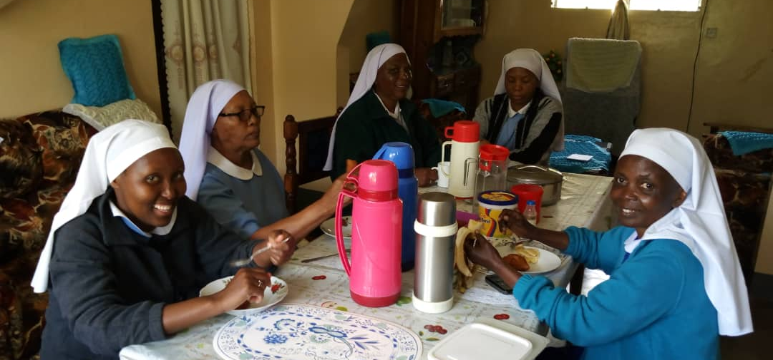
Daughters of Mary at their Endulen Convent in the Ngorongoro Game Reserve in the Arusha Archdiocese of Tanzania

Slide 23
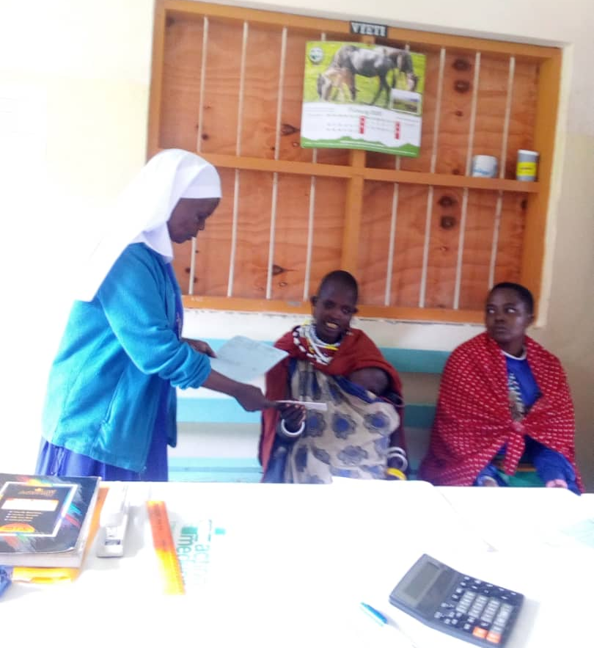
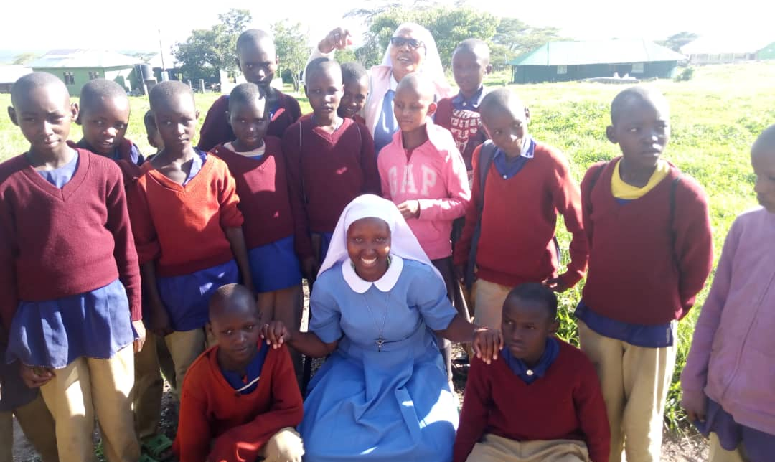
They serve the Masai
a Pastoralist Tribe of Tanzania and Kenya

Slide 24
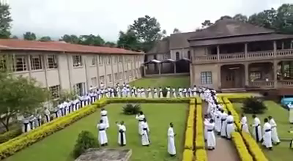
Seminarians from Kigoma Diocese of Tanzania
Gathered with other seminarians at conclave in Dar es Salaam

Slide 25
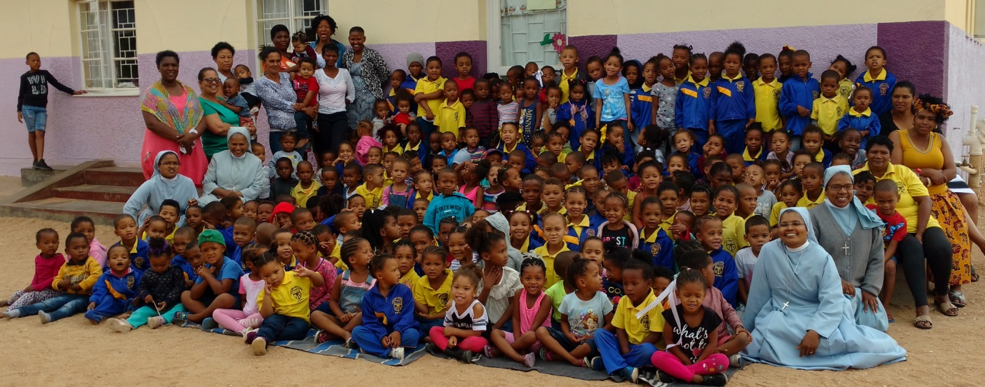
Daughters of St Francis de Sales
Guardian Angel Nursery School
Northern Cape Province, South Africa

Slide 26
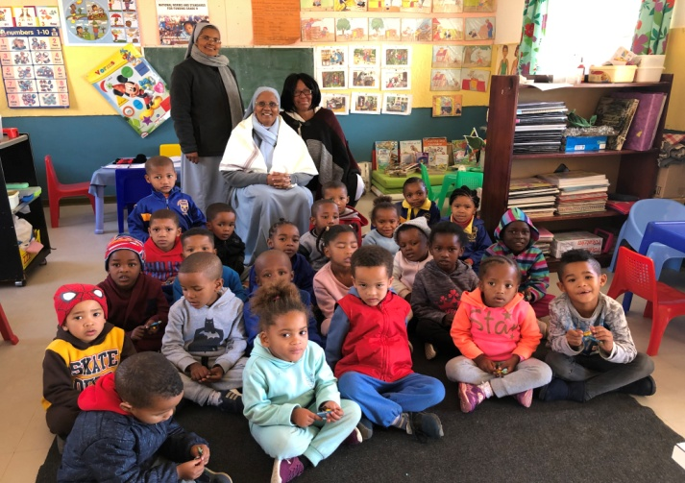
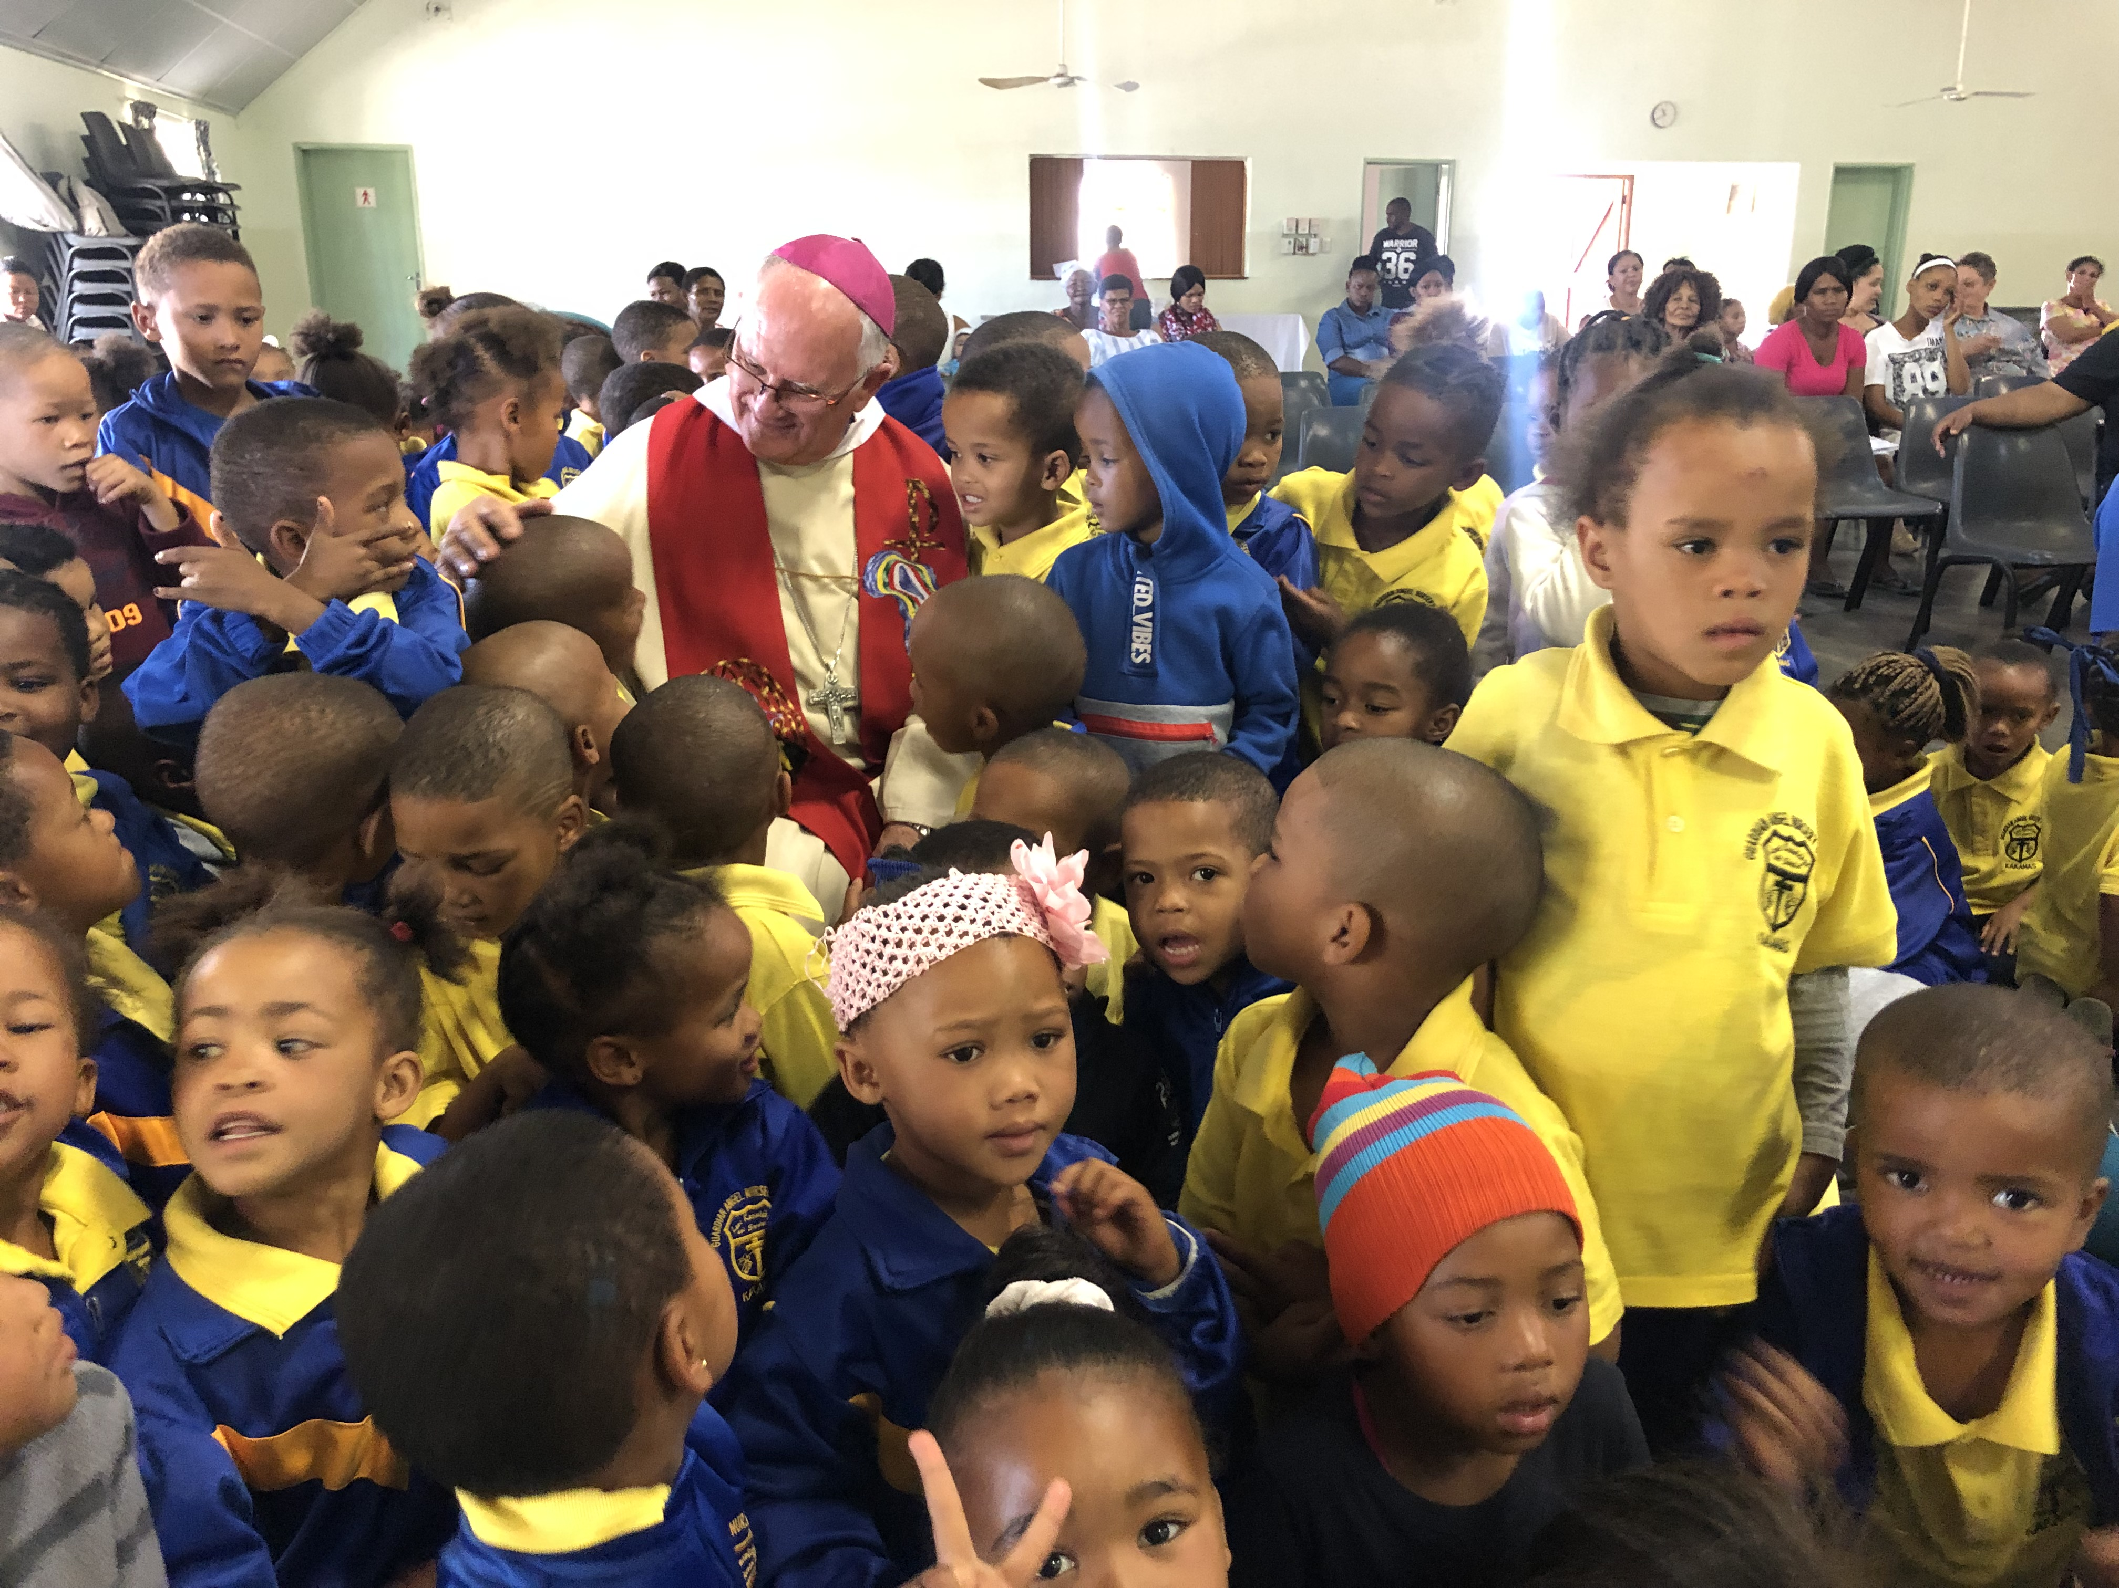
St. Cyprian Parish of Kakamas in the in the Keimoes-Upington Diocese

Slide 27
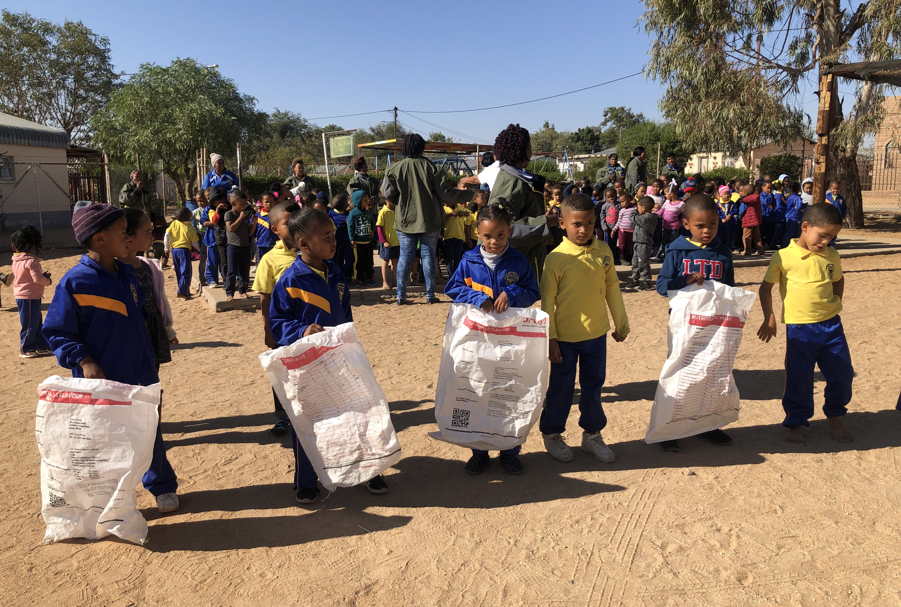
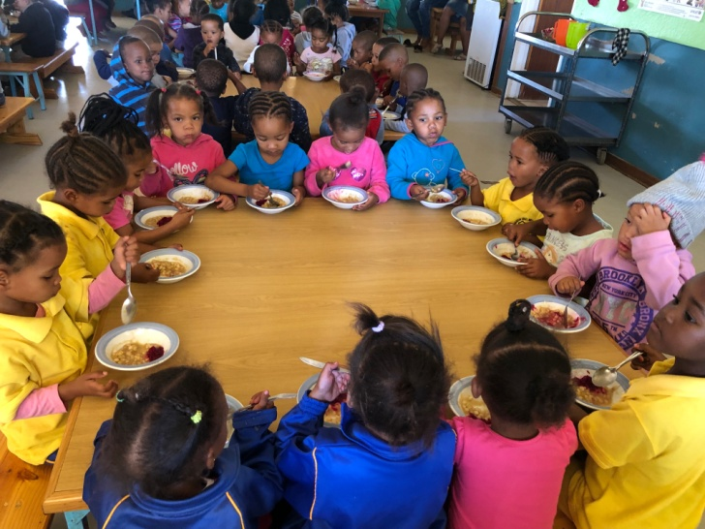
Play time
Meal time

Slide 28
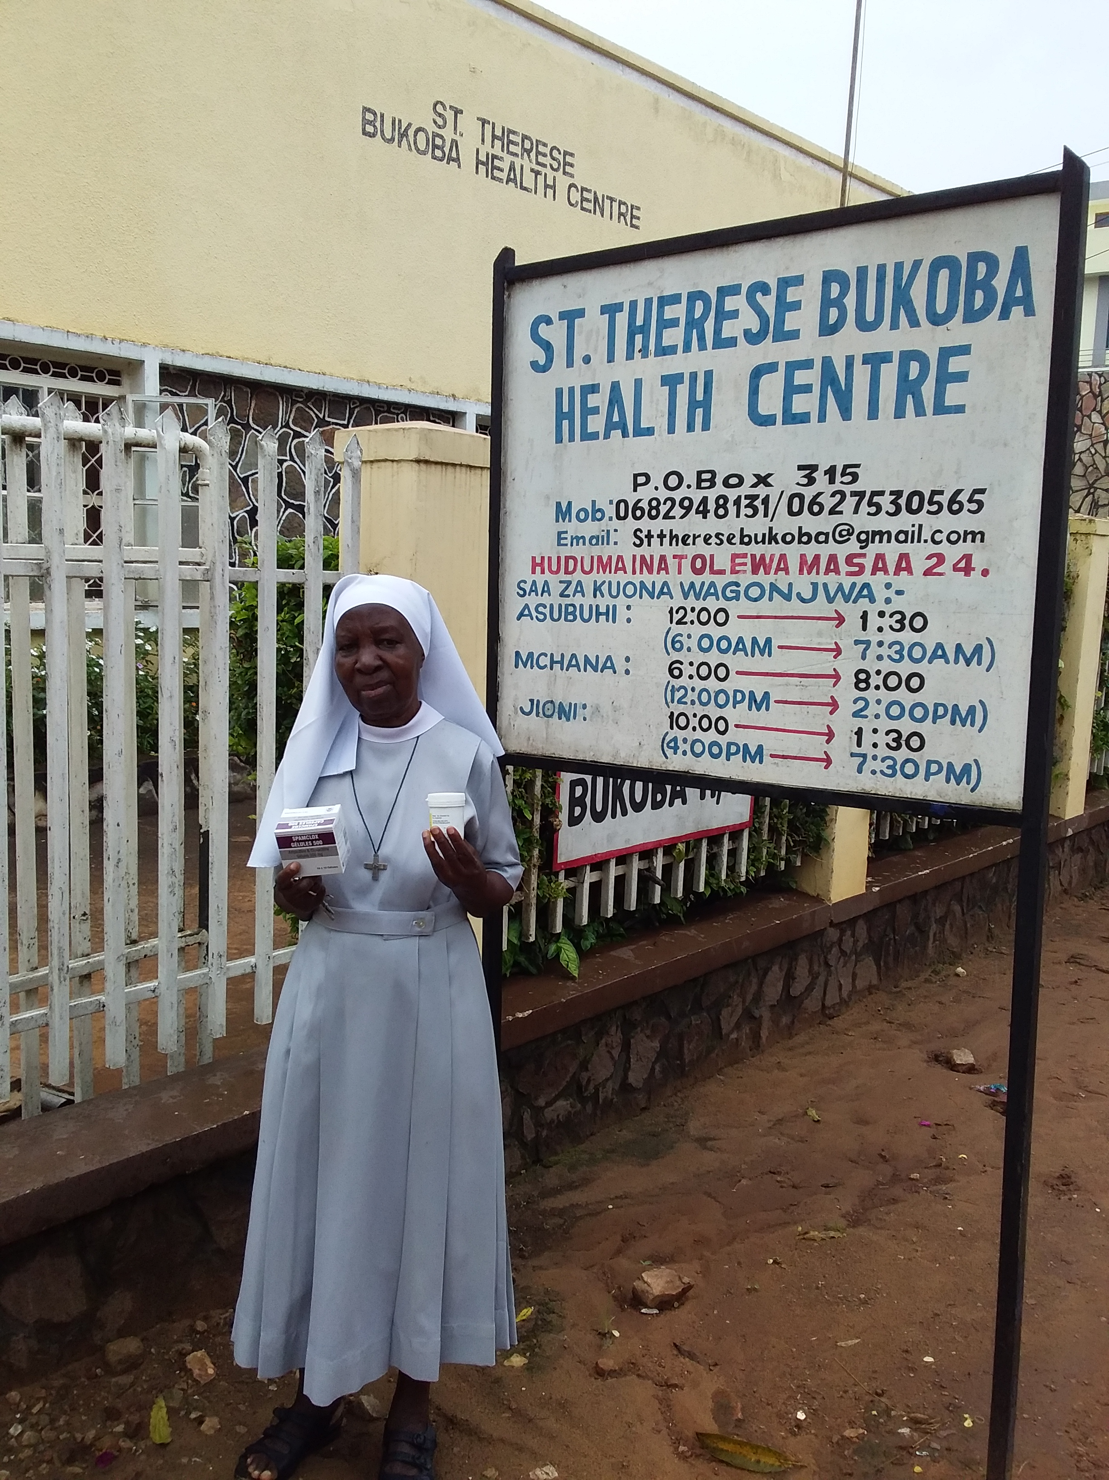
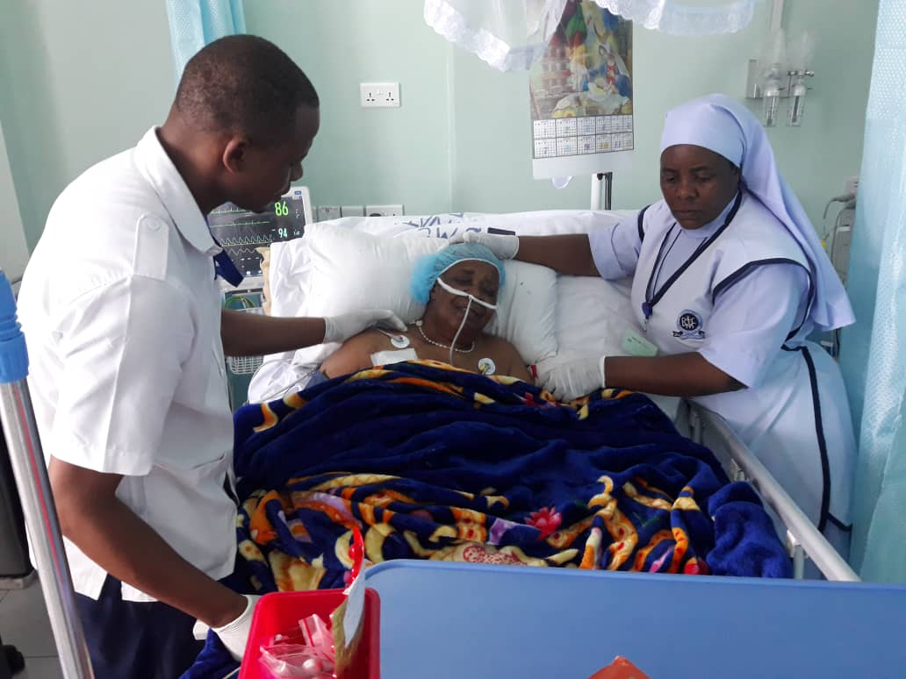
St Therese Sisters of the Child Jesus, Bukoba Diocese

Slide 29
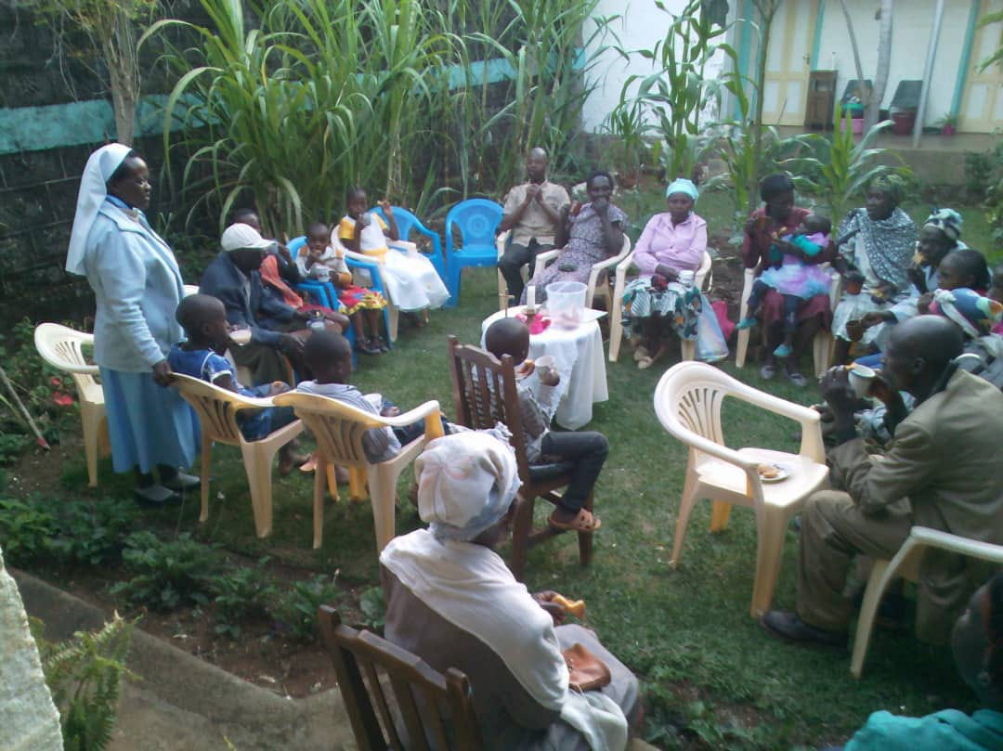
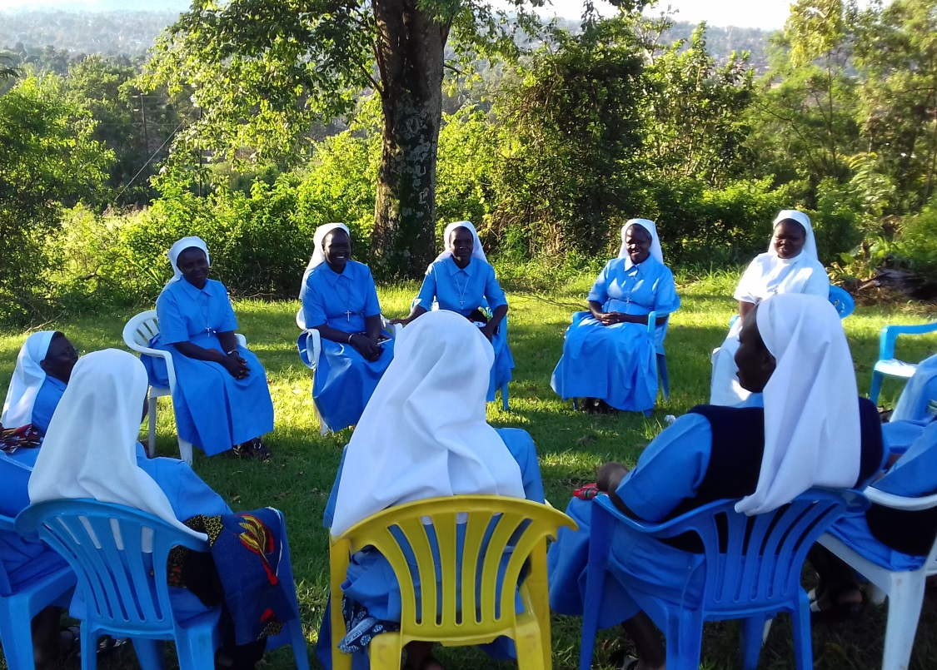
Evangelizing Sisters of Mary
Generalate in Nairobi, Kenya

Slide 30
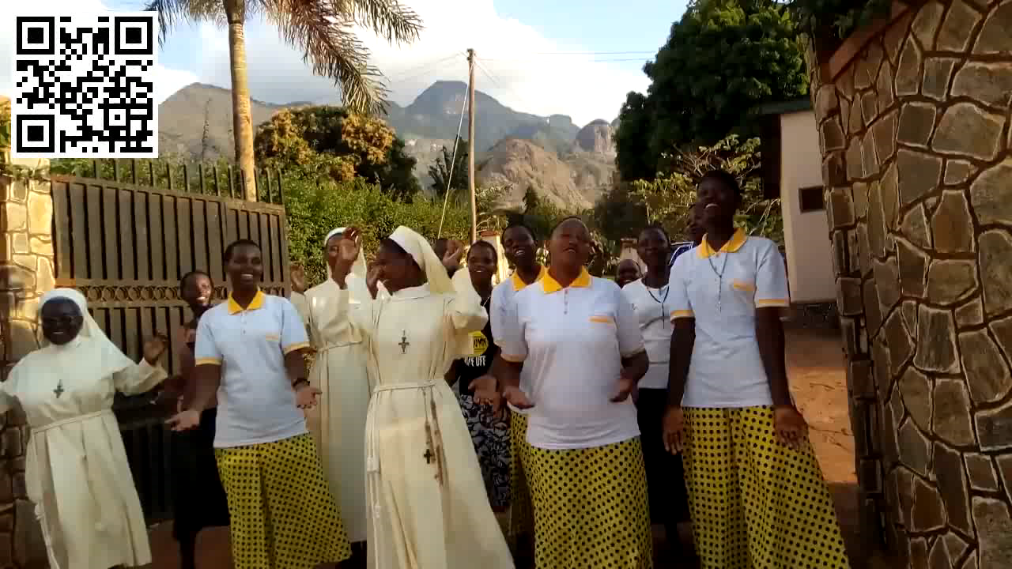
Franciscan Missionary Sisters
of the Holy Eucharist Morogoro, Tanzania

Slide 31
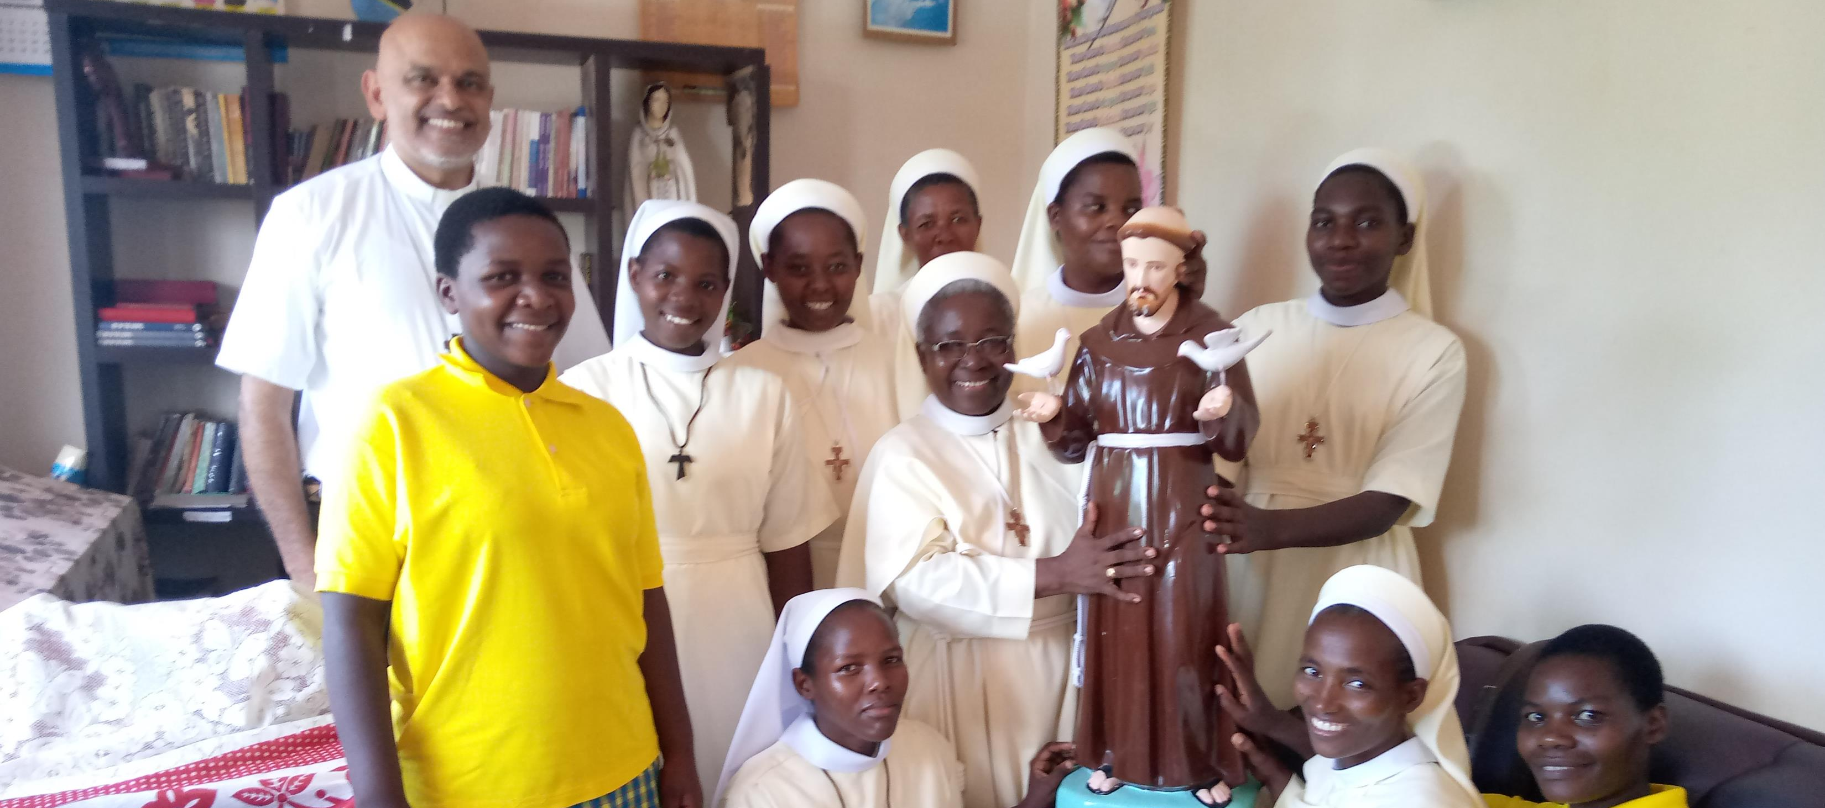
Mother Cordula with the FMSE Sisters and statue of St Francis of Assisi

Slide 32
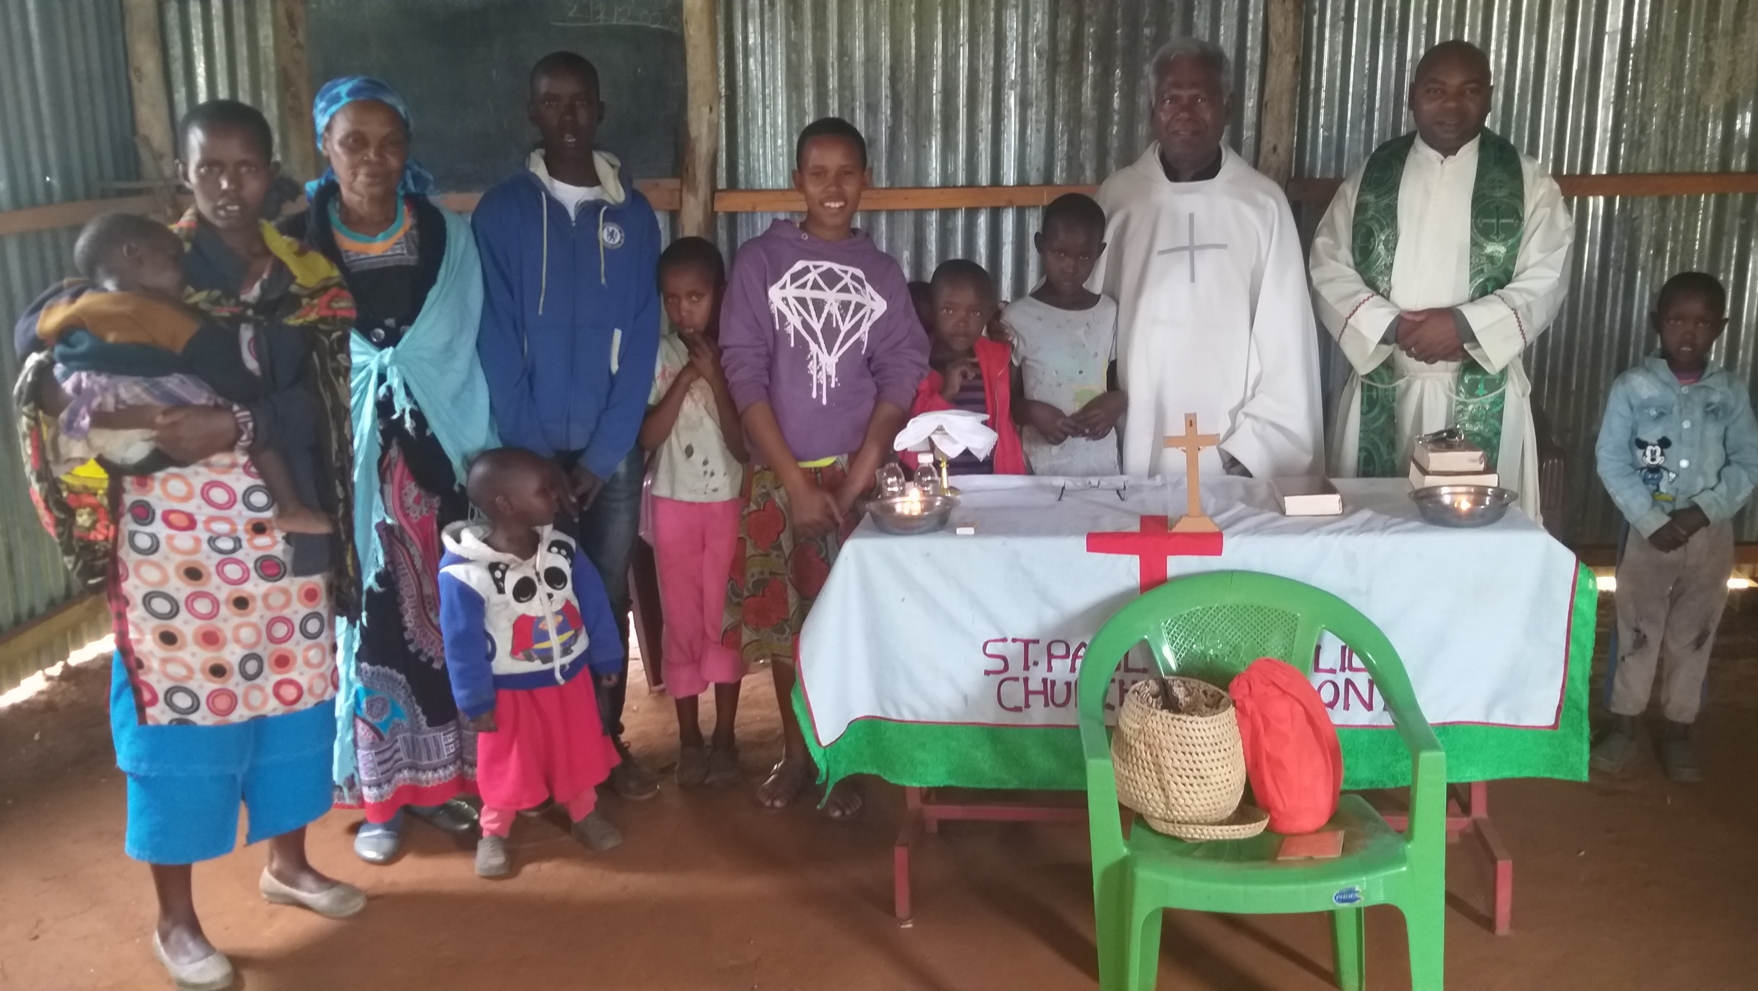
Fathers Augustine and Aristidus Celebrating Mass at interior Masai village at Il Bissil, Kenya

Slide 33
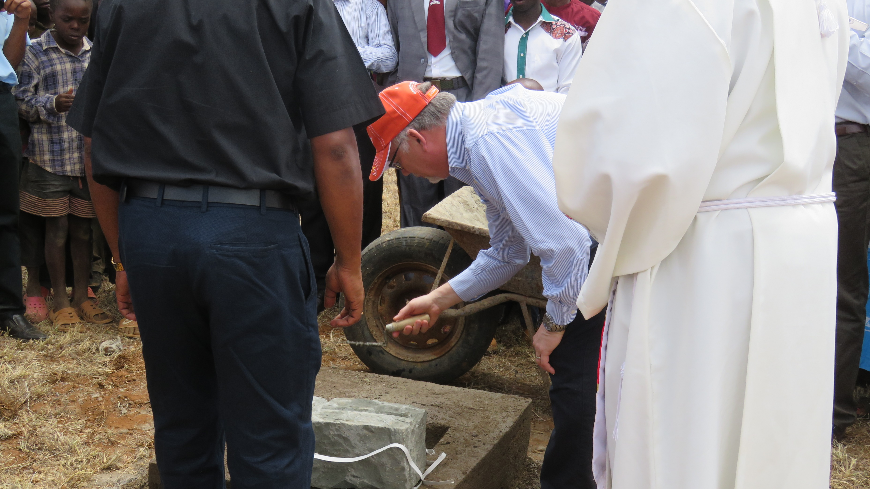
Brian Prunty laying the cornerstone for the Primary School at II Bissel, Kenya
with Fathers Mathew and Samy and the local community looking on

